Slide 1
Recent Developments in Conflict of Commitment
Phil Cunningham
Tom Cavalier
Gail Ryan

Slide 2
Foreign Influence
Guidance Regarding Management of International Relationships and Activities
The federal government and several federal sponsors have expressed growing concerns regarding the potential for improper foreign influence over academic research having a foreign component. The focus on potential conflict of commitment involving foreign entities began around 2018.
Reminders have been issued highlighting the importance of ensuring compliance with existing and new policies and regulations, including those related to full disclosure of foreign engagements, conflicts of interest, and conflicts of commitment.
https://research.wayne.edu/news/guidance-regarding-management-of-international-relationships-and-activities-32670

Slide 3
Foreign Influence
Any work done outside of the United States must be disclosed in grant proposals, progress reports, and final technical reports.
Potential conflicts of interest – either foreign or domestic – must be identified and managed appropriately in accordance with the Research Policy on Financial Conflict of Interest and Commitment.

Slide 4
Foreign Influence
Guidance Regarding Management of International Relationships and Activities
Our goal today is to:
Describe the federal laws/regulations and university policies regarding conflict of commitment and how they affect us;
provide an update on recent developments in this area;
and review measures we have taken to inform and facilitate compliance by the WSU community and institution with these laws and regulations.

Slide 5
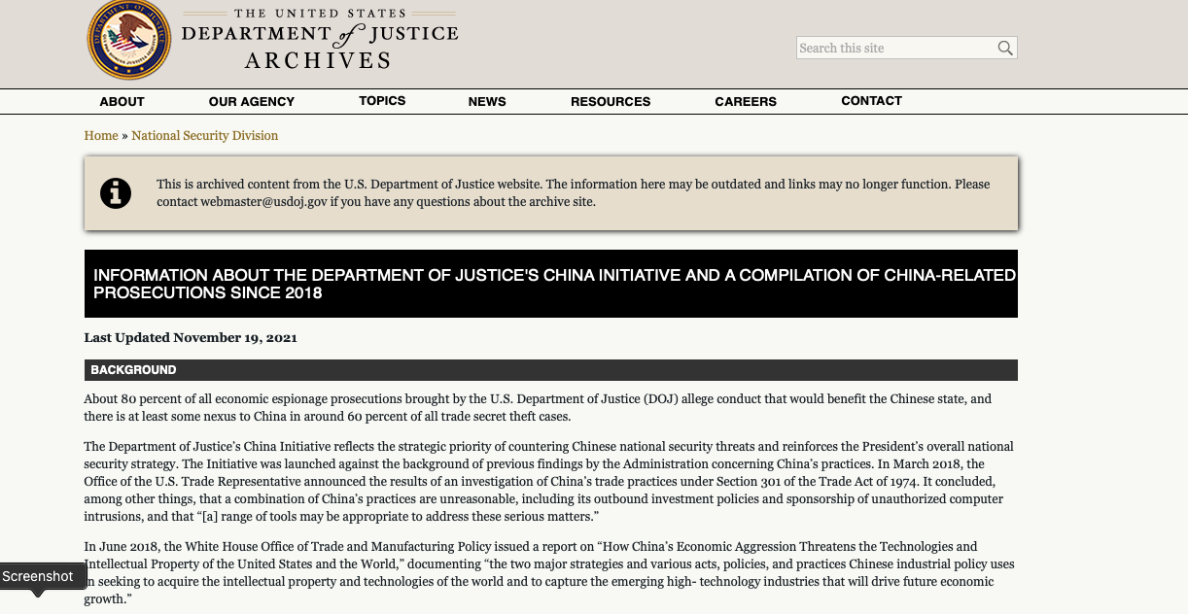
Evolution of the China Initiative
https://www.justice.gov/archives/nsd/information-about-department-justice-s-china-initiative-and-compilation-china-related

Slide 6
the China Initiative Attorney General Jeff Sessions Announces New Initiative to Combat Chinese Economic Espionage Washington, DC ~ Thursday, November 1, 2018
“I am announcing that I have ordered the creation of a China Initiative led by Assistant Attorney General John Demers, who heads our National Security Division, and composed of a senior FBI Executive, five United States Attorneys including Alex, and several other Department of Justice leaders and officials, including Assistant Attorney General for our Criminal Division, Brian Benczkowski.
This Initiative will identify priority Chinese trade theft cases, ensure that we have enough resources dedicated to them, and make sure that we bring them to an appropriate conclusion quickly and effectively.”
https://www.justice.gov/opa/speech/attorney-general-jeff-sessions-announces-new-initiative-combat-chinese-economic-espionage

Slide 7
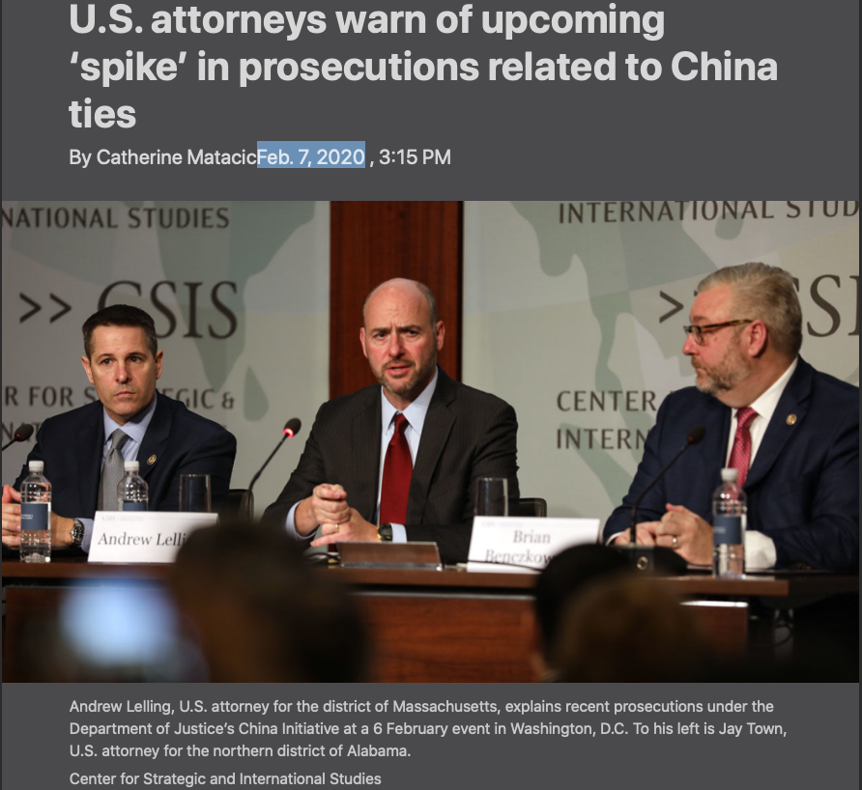
Foreign Influence
Researchers in academia and industry who work with Chinese institutions should expect a “spike” in prosecutions this year as a result of a U.S. government initiative to stop economic espionage, say federal prosecutors leading the effort. And although they say the criminal cases could harm potentially useful U.S. collaborations with China, the prosecutors believe they will help deter future problems.
Science. Feb. 7, 2020

Slide 8
Foreign Influence
Failure to comply with the disclosure and management regulations and laws may result in criminal prosecution of the responsible individuals (faculty, staff, administrators, and institutions).

Slide 9
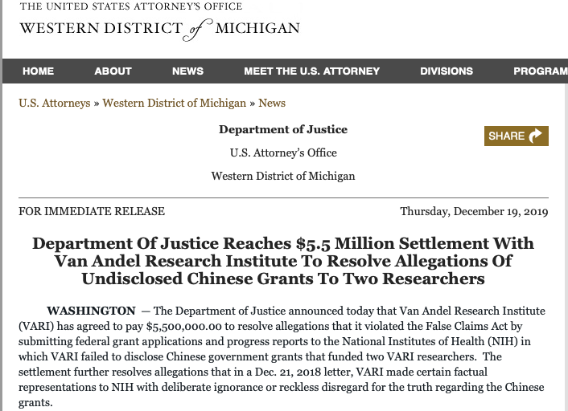
Foreign Influence

Slide 10
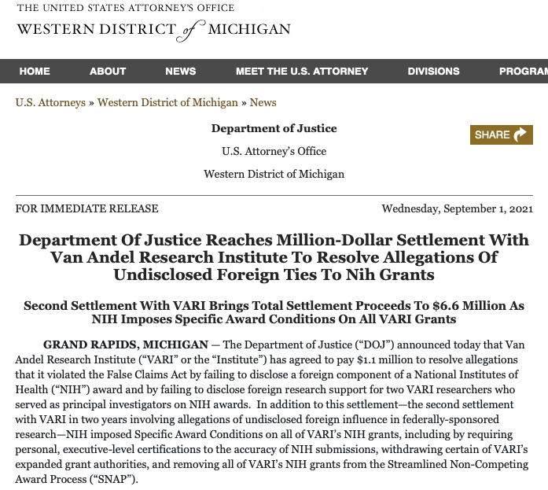
Foreign Influence

Slide 11
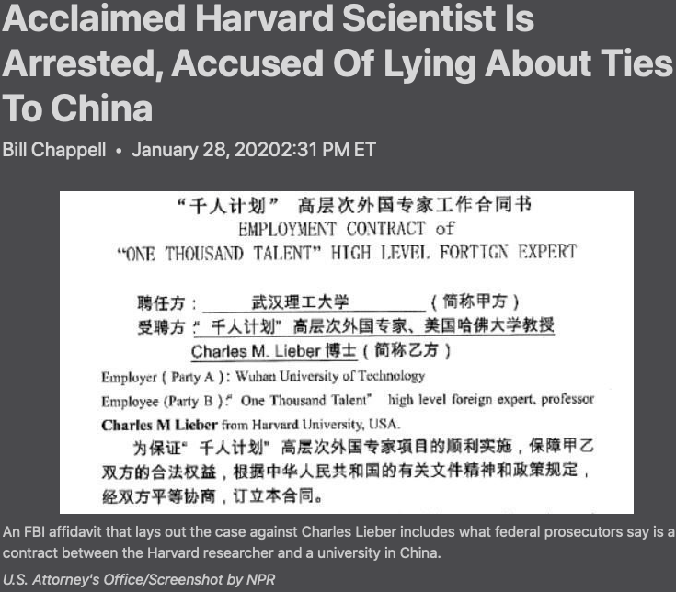
Foreign Influence
Charles Lieber, the chair of Harvard University's Department of Chemistry and Chemical Biology, has been arrested and criminally charged with making "false, fictitious and fraudulent statements" to the U.S. Defense Department about his ties to a Chinese government program to recruit foreign scientists and researchers.
The Justice Department says Lieber, 60, lied about his contact with the Chinese program known as the Thousand Talents Plan, which the U.S. has previously flagged as a serious intelligence concern. He also is accused of lying about a lucrative contract he signed with China's Wuhan University of Technology.
National Public Radio
Bill Chappell January 28, 2020 2:31 PM ET

Slide 12
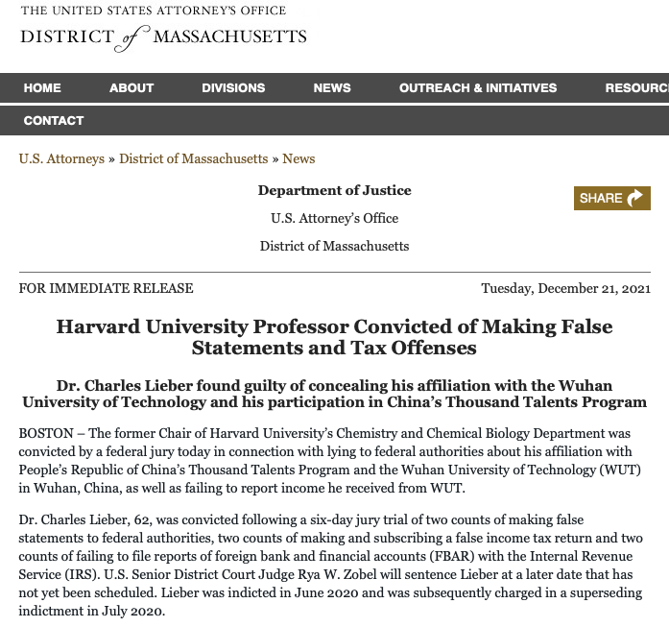
Foreign Influence

Slide 13
Video shows Harvard professor initially denying bringing cash payments back from China
“Charles Lieber, the scientist, was shown on video denying having brought back tens of thousands of US dollars from China before acknowledging he put it in his luggage and spent it on groceries to avoid paying income taxes.
Lieber is on trial in US District Court in Boston facing six total counts of tax evasion, failing to disclose foreign bank accounts and hiding his collaboration with Chinese institutions.”
South China Morning Post
https://www.scmp.com/news/china/science/article/3160209/video-shows-harvard-professor-initially-denying-bringing-cash

Slide 14
Science: 28 FEB 2022 Controversial U.S. China Initiative gets new name, tighter focus on industrial espionage Scientists hope rebranding ends racial profiling and targeting of academics for paperwork errors
Since its launch in 2018 under then-President Donald Trump, the China Initiative has resulted in criminal charges against some two dozen academic scientists, typically for failing to tell U.S. funding agencies about their financial ties to Chinese institutions. Most of the defendants were of Chinese origin. Although several pled guilty and were sentenced to prison terms, prosecutors dropped other cases and only one scientist, Harvard University chemist Charles Lieber, has been convicted by a jury.
Last week, Assistant Attorney General Matthew Olsen, who took over DOJ’s national security division in November 2021, announced the initiative will now be called “a strategy for countering nation-state threats.”
https://www.science.org/content/article/controversial-u-s-china-initiative-gets-new-name-tighter-focus-industrial-espionage

Slide 15
Nature NEWS: 22 September 2022 Convictions reversed for US chemical engineer accused of hiding China ties
“The reversal follows a string of failures by the US Department of Justice (DoJ) to bring strong convictions under the umbrella of the China Initiative, and could mark a new chapter for the US scientists of Chinese heritage who have feared government surveillance in the wake of the programme’s launch.”
https://www.nature.com/articles/d41586-022-03007-w?utm_source=Nature+Briefing&utm_campaign=8228b36cad-briefing-dy-20220923&utm_medium=email&utm_term=0_c9dfd39373-8228b36cad-43282925

Slide 16
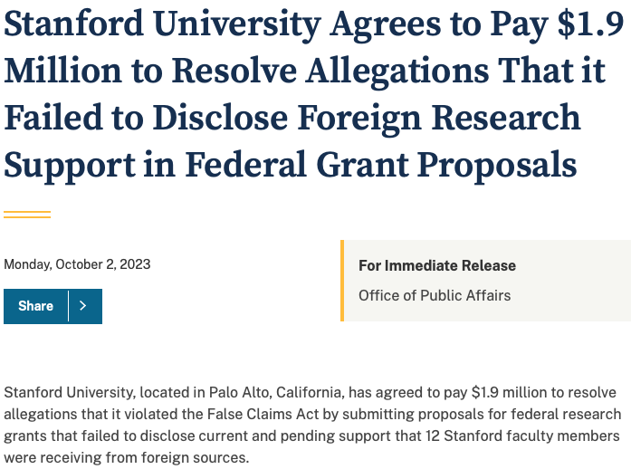
https://www.justice.gov/opa/pr/stanford-university-agrees-pay-19-million-resolve-allegations-it-failed-disclose-foreign

Slide 17
https://www.justice.gov/opa/pr/stanford-university-agrees-pay-19-million-resolve-allegations-it-failed-disclose-foreign
Stanford University Agrees to Pay $1.9 Million to Resolve Allegations That it Failed to Disclose Foreign Research Support in Federal Grant Proposals
“Complete and accurate disclosures by principal investigators and universities of current and pending support are essential to federal agencies that make decisions on awarding federal grants,” said U.S. Attorney Erek Barron for the District of Maryland. “Those individuals and universities that knowingly fail to do so skew the grant awarding process in their favor and will be held accountable.”

Slide 18
https://www.justice.gov/opa/pr/stanford-university-agrees-pay-19-million-resolve-allegations-it-failed-disclose-foreign
Stanford University Agrees to Pay $1.9 Million to Resolve Allegations That it Failed to Disclose Foreign Research Support in Federal Grant Proposals
“This settlement demonstrates the Office of Procurement Fraud’s determination and commitment to identify and hold accountable those who conceal foreign affiliations to obtain research funding,” said Special Agent in Charge William W. Richards of the Air Force Office of Special Investigations (AFOSI). “AFOSI, along with our law enforcement and prosecutorial partners, will continue to work tirelessly to protect the integrity of the federal grant process."

Slide 19
What is the legal Basis of the foreign influence prosecutions?
Tom Cavalier, Assoc. Counsel
Office of the General Counsel

Slide 20
foreign influence
MAKING A FALSE STATEMENT TO THE FEDERAL GOVERNMENT
It is a crime to “knowingly and willfully… make any materially false, fictitious, or fraudulent statement” to the federal government.
The crime is punishable by up to five years in prison and a $250,000 fine.

Slide 21
foreign influence
In December 2021, Charles Lieber was convicted by a jury of two counts of making a false statement to federal agencies, one count of filing a false income tax return, and one count of failing to disclose a foreign bank account to the IRS.
In September, the federal judge hearing the case denied Lieber’s motion for an acquittal or a new trial.
He was sentenced to time served – 2 days in prison; 2 years supervised release with 6 months home confinement; $55,000 fine; $36,000 restitution to IRS.

Slide 22
foreign influence
Lieber’s False Statement # 1
Department of Defense investigators asked Lieber whether he was “[a]pproached to be a member” of the Thousand Talents Program.
Lieber replied that he was “not explicitly asked to be a member”, and immediately added, he was “not sure how they categorized” him.
Jury found that Lieber had made a false statement to the Department of Defense.

Slide 23
foreign influence
Lieber’s False Statement # 2
Lieber told Harvard officials that he was not a member of the Thousand Talents Program.
Harvard officials wrote the NIH stating what Lieber had told them. Lieber reviewed the letter and did not correct the error.
Jury found that Lieber had made a false statement to the NIH by causing Harvard to falsely represent to the agency that he had never participated in the Thousand Talents Program.

Slide 24
foreign influence
Feng “Franklin” Tao
Professor of Chemistry and Engineering, Kansas University
April, 2022: Tao is convicted by a jury of three counts of wire fraud and one count of making a false statement.
September, 2022: The federal judge hearing the case overruled jury verdicts on the wire fraud charges, but sustained conviction on making a false statement. He was sentenced to time served – one week in prison

Slide 25
foreign influence
Tao’s False Statement
Tao had developed a relationship with Fuzhon University. He was appointed as a Distinguished professor and was offered employment for five years.
He never signed an employment agreement and did not receive any compensation. Tao did recruit graduate students and post-docs to Fuzhon, and helped to set up a lab there.

Slide 26
foreign influence
Tao received a grant from the NSF. The agency requires all grantees to have a conflict of interest policy and to manage, reduce, or eliminate any conflicts of interest before expenditure of grant funds.
KU’s conflict of interest and commitment policy requires faculty to complete an Institutional Responsibilites form where they are to disclose “all external personal professional activities.”

Slide 27
foreign influence
Tao never disclosed his relationship with Fuzhon on his Institutional Responsibilities forms, even though he certified them as complete.
By falsely certifying his Institutional Responsibilities forms and withholding his affiliation with Fuzhon, Tao misled NSF into believing that all of his potential conflicts had been addressed by KU.

Slide 28
foreign influence
Zhengdong Cheng
Former Professor, Texas A&M, College Station
September 2022: Pled guilty to two counts of making false statements to NASA.
Sentence: Thirteen months’ time served in prison
Repay $86,876 in grant funds
Fined $20,000

Slide 29
foreign influence
Cheng’s False Statement
Cheng worked for two Chinese universities before and after he was awarded a grant from NASA.
NASA grants prohibit the PI from participation, collaboration or coordination with China, any Chinese-owned company or any Chinese University.
Cheng never disclosed his affiliation with the Chinese universities to NASA.

Slide 30
Compliance with Federal Disclosure Laws as it Relates to Federal Grants
Gail Ryan, Assoc. Vice President
Sponsored Program Administration
Division of Research

Slide 31
Foreign Influence
According to the NIH Grants Policy Statement, the definition of a foreign component is:
“The performance of any significant scientific element or segment of a project outside of the United States, either by the recipient or by a researcher employed by a foreign organization, whether or not grant funds are expended.”

Slide 32
Foreign Influence
Activities that meet this definition include, but are not limited to,
• The involvement of human subjects or animals,
• extensive foreign travel by recipient project staff for the purpose of data collection, surveying, sampling, and similar activities, or
• any activity of the recipient that may have an impact on U.S. foreign policy through involvement in the affairs or environment of a foreign country.

Slide 33
Foreign Influence
Examples of other grant-related activities that may be significant are:
collaborations with investigators at a foreign site anticipated to result in co-authorship;
use of facilities or instrumentation at a foreign site or;
receipt of financial support or resources from a foreign entity.
Foreign travel for consultation is not considered a foreign component.

Slide 34
Foreign Influence
Issues most commonly found by the Feds:
Undisclosed sources of foreign research support
Undisclosed conflicts of interest
Violations of peer review integrity rules

Slide 35
Proposal Submission
If there is an anticipated foreign component, researchers must check yes to question 6 on the "R&R Other Project Information" form "Does this project involve activities outside of the United States or partnerships with international collaborators?"
A "Foreign Justification" attachment in Field 12 "Other Attachments” must be included. This should describe the special resources or characteristics of the research project (e.g., human subjects, animals, disease, equipment, and techniques), including the reasons why the facilities or other aspects of the proposed project are more appropriate than a domestic setting.

Slide 36
Other Support
Domestic and foreign grants and contracts, whether provided through WSU, another institution, or to the researcher directly;
Financial support for laboratory personnel
Provision of lab space at another institution, foreign or domestic;
Provision of scientific materials that are not freely available for use at WSU or another institution where the faculty is working
Travel and/or living expenses directly paid or reimbursed by an outside entity;
Other funding (e.g., salary, stipend, honoraria, etc.) paid by an outside entity.
Internal awards provided by WSU.

Slide 37
Other Support
Effective May 25, 2021, NIH requires the following:
Supporting documentation, which includes copies of contracts, grants or any other agreement specific to senior/key personnel foreign appointments and/or employment with a foreign institution for all foreign activities and resources that are reported in Other Support. If the contracts, grants or other agreements are not in English, recipients must provide translated copies.
Immediate notification of undisclosed Other Support.

Slide 38
NIH Resources
https://grants.nih.gov/grants/forms/NIH-Disclosures-Table.pdf

Slide 39
What are we doing to protect our community and institution?
Notices regarding foreign influence resources and updates were sent to WSU faculty by the VPR and the Provost.

Slide 40
What are we doing to protect our community and institution?
See the WSU web site on Foreign Influence.
https://research.wayne.edu/news/guidance-regarding-management-of-international-relationships-and-activities-32670
This site contains up-to-date information on conflict of commitment and foreign influence.

Slide 41
What are we doing to protect our community and institution?
Because the majority of prosecutions result from failure by faculty and institutions to disclose interactions with foreign entities, a separate Conflict of Commitment form was added to our Financial Conflict of Interest disclosure.
The PI certification form in Cayuse asks about any foreign involvement. When this question is answered “yes”, it directs the PI to complete a Conflict of Commitment disclosure.

Slide 42
What are we doing to protect our community and institution?
When a completed disclosure is received, it is reviewed to determine if additional disclosures are needed to comply with federal regulations and laws.
See: https://research.wayne.edu/integrity/conflict-of-interest
and: https://ksprodweb.ovpr.wayne.edu

Slide 43
What are we doing to protect our community and institution?
If you would like additional information regarding a government grant proposal, please contact your grants officer at the WSU Sponsored Program Administration.
For other concerns relating to Foreign Influence issues, please contact either Gail Ryan (gail.ryan@wayne.edu) or Phil Cunningham (philc@wayne.edu).
For assistance with the disclosure forms please contact Ginette Borovicka at:
Ph.: 313-577-1862
Email: Ginette@wayne.edu

Slide 44
Questions or Comments?

