Slide 1
Data Management for Multi-Center Clinical Trials
Diane Chugani
Department of Pediatrics

Slide 2
Internal or Contracted Data Management?
As the DCC for the ACE Network, KAI will:
1. Develop study materials - Design eCRFs and instructions for their completion; source documents, screening logs; drug logs, tracking logs and an Operations Manual.
2. Customize KAI eCRF system and provide data management activities – Implement a clinical data management system (CDMS) for collecting, managing, editing, storing, and reporting on data. System provides query tracking, data editing, medical coding and interfaces with KAI’s Interactive Voice Recognition System (IVRS) for participant randomization.
3. Provide clinical site and monitoring support - Collect regulatory documents, financial disclosure information, and informed consent forms; verify regulatory documents including IRB approvals; train site staff; conduct site initiation visits; monitor sites including drug accountability, query resolution and study closeout. Importantly, insure that study conduct and operations are in compliance with the study protocol, GCP, and FDA regulations.
4. Provide meeting and logistics support for investigator’s meeting - Plan and coordinate the meeting, present study materials and training, and provide written minutes.
5. Provide medical coding and assistance with IND reporting - Provide a Medical Monitor who is available to code all adverse events and concomitant medications; promptly prepare IND safety reports for serious adverse events (SAEs) requiring expedited reporting to the FDA and assist with the annual IND updates.

Slide 3
Data Management Capabilities
KAI has an Internet-based clinical data management system, Smart Study™©, that combines robust data capture with study management tools. It makes use of thin client architecture that allows all data and systems to reside on the KAI network. Smart Study™© is comprised of thirteen dynamic linked libraries (DLL) which handle the processing and checking of data, from the data entry screen until storage in the MS SQL server tables. Smart Study™© also takes advantage of Microsoft’s ADP technology which allows for easy creation of tables and generation of reports. Programmer intervention is only required to carry out complex cross form edits. Thus, it is easily customized according to the data requirements of a specific study and can be ready for implementation within six weeks of protocol completion and sign-off. Smart Study™© supports remote data capture and study management through the Web as well as centralized data entry at KAI. It has been used in numerous biopharmaceutical studies and studies sponsored by the National Institutes of Health (NIH).

Slide 4
Validation and System Security
The Smart Study ™© system has been validated and audited by the KAI’s Quality Assurance (QA) department and by independent auditors in preparation for FDA regulatory submissions, in accordance with FDA Part 11 guidelines. All documentation of testing and validation processes is maintained on-site at KAI. The system produces an audit trail that tracks all changes made to the data item and records pre/post change values, date and time of change, and individual making the change. The system meets all requirements set forth in the FDA 21 CFR Part 11 document. The system is in compliance with HHS, Automated Information Systems Security Program Handbook (AISSP) Release 2.0 and Year 2000 Warranty. Entry to Smart Study ™© requires a user name and password. The user is automatically prompted to change their password according to a set schedule determined by the sponsor. After three incorrect username or password attempts the user is locked out of the system and must contact KAI to be allowed back into the system. After a set period of inactivity the system disconnects the user. All KAI applications and systems, data and programs are copied to tape (DLT) on a daily, weekly and monthly basis. Weekly and monthly tapes are stored off site in a secure temperature controlled facility.

Slide 5
System Features
Site Data Entry Using the Internet – Data are entered from eCRFs at study sites, or, as necessary, from paper forms entered centrally; all data are encrypted prior to transmission through the Internet.
Graphic Interface - System access and navigation are facilitated by a Windows Explorer type interface that graphically displays sites, participants, forms, and form status by study. The familiarity of the interface facilitates new user training.
Smart Study – Web browser independent and has been used on Windows and Apple platforms using Explorer, Firefox and Safari browsers.
Rigorous Data Editing – Edits are programmed to check out-of-range and missing data as well as errors in logic (e.g., age is less than six years where the protocol defined inclusion/exclusion criteria specify six as the minimum age) to meet the needs of each protocol.
Audit Trails – Audit trails are created that meet the requirements set forth in 21 CFR Part 11. The audit trails capture and time stamp changes made to the data, annotations, comments, and data flags.
Tracking and Project Management – Through the use of real time reports, the system tracks patients and CRF form history and status, thus integrating study management requirements with study clinical data collection requirements. Problems such as missing visits and/or forms can immediately be brought to the attention of the study investigators. Sponsors can review these reports in a read-only mode while Investigators can review only their site's data.

Slide 6
System features—cont.
Electronic Signatures – All approvals by monitors and Principal Investigators (PI) require electronic signatures, constituted by the entry of a user name and a distinct approval password.
CRF Conversion to PDF- All CRFs can be converted in batch to PDF files for inclusion in FDA submissions.
Statistical Analyses – Data tables interface directly with SAS.
Transmission – All data are encrypted at 128 bits prior to internet transmission and no data reside at the participating sites.
Adverse Event Coding and Tracking - The system is integrated with KAI's adverse event system and thus events identified during a study can be immediately coded and reported, as necessary.
Compatibility with Other Commercial Systems and File Types- The system’s tables and data fields are compatible with other commercial clinical data management systems. Utilities are available to easily transfer data to and from Smart Study™©. In addition, KAI can accept data from external sources in formats which include Excel, ASCII files, Access tables and SAS datasets. KAI also can accept data in most tape formats, CD and diskettes.
Upload data to NDAR (data repository)- KAI will upload data incrementally to NDAR as requested. KAI has worked closely with data repositories for other projects and therefore is very experienced in this process.

Slide 7
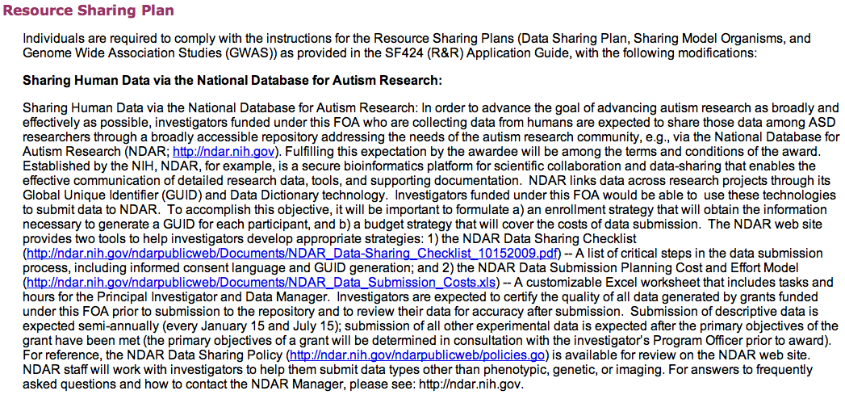

Slide 8
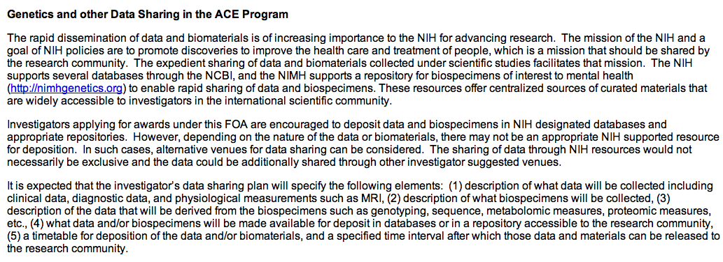

Slide 9
Summary
Data management may be done locally or through contracted services
Validation management system meets FDA or other regulatory agencies
Staffing to produce necessary reports
Data sharing—differs with agency and area of research: Use RFA as guide, consult with agency program staff

