Slide 1
Contract Negotiation Basics for Sponsored Programs
SPA Training

Slide 2
Sponsored Programs Administration
Contracts Group
Patty yuhas kieleszewski: Associate Director
Liane Howey: Grant & Contract officer – clinical trials
Rissa long: Grant & Contract officer - non-clinical trial agreements
Michael maher: grant & contract officer - subcontracts/risk management

Slide 3
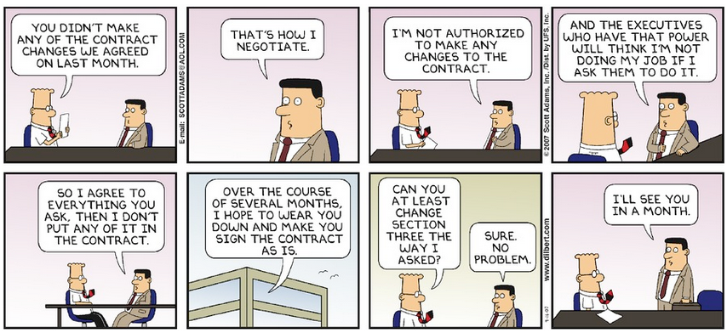

Slide 4
What’s In a Name?
subaward
memorandum of understanding
purchase order
agreement
letter of agreement

Slide 5
applied research, evaluation, training, demonstrations, material transfers, confidentiality terms, equipment loans, and more
What’s a Contract?
if the content includes specific terms and conditions governing the performance of research, it is considered by WSU to be a research contract

Slide 6
Specifically…
Legally enforceable agreement
between two or more parties
Has specific deliverables and milestones
Quid pro quo relationship
Wayne State University , rather than the PI is the contracting partner

Slide 7
Contracts awarded to WSU

Slide 8
Bigger Picture
External Funding
Assistance Award
Grant
Cooperative Agreement
Procurement Award
Contract

Slide 9
What a contract IS NOT
Assistance Awards
Grant
Cooperative Agreement
Grants are assistance awards. A federal grant is an award of financial assistance from a federal agency to a recipient to carry out a public purpose of support or stimulation authorized by a law of the United States
A grant may be donative in nature, bestowed voluntarily, and without expectation of tangible compensation
Grant agreements do not typically require signatures and are non-negotiable documents

Slide 10
Two Main Types of Contracts Processed by SPA Contracts Group
Contracts with Industry
Clinical Trials
Contracts with Federal and State government

Slide 11
Key Documents
Administrators and researchers are expected to complete certain documents such as a Statement of Work and a formal Research Contract. Often, sponsors request that other documents also be filled out and signed:
Memorandum of Understanding – a Contract that outlines the terms and conditions of a project.

Slide 12
Key Documents
Data Use Agreement – a Contract that outlines the terms and conditions governing the use of an entity’s data. These agreements are commonly required for access to various Federal Databases
Non-Clinical Confidential Disclosure Agreement/Non-Disclosure Agreement/Proprietary Information Agreement – a Contract that outlines the disclosure and use of proprietary information. Generally WSU is affirming that it will not disclose the other party’s confidential information

Slide 13
Key Documents
Equipment Loan Agreement – a contract that outlines the terms and conditions for equipment being loaned to WSU
Allocation of Rights – a contract that outlines who owns Intellectual Property before, during, and after a project
License Agreements – a contract that outlines terms and conditions of use. SPA processes these when the item is being loaned or donated to WSU for a research project. Purchasing processes these when an item is being purchased.

Slide 14
Key Documents
Supplier Agreements – these are forms of various lengths asking for information such as Federal Identification Number, DUNS Number, type of business, banking information for wire transfers, etc. Vendors need this information in order to process payments to WSU for your hard work. Contract Administration keeps this information on file.
All contracts are reviewed by WSU Office of General Counsel, Research Compliance, Export Control, and Technology Commercialization as applicable

Slide 15
Break it Down: Industry Research Contracts -
Agreements with for profit sponsors cover many activities including basic, applied, or developmental research, collaborative research, and various types of testing

Slide 16
Federal and State Contracts
Contract negotiations with a government agency primarily focus on budget and scope of work issues.
Terms and conditions of the award are usually fixed by law or regulation. However, it is important to ensure the terms and conditions imposed by the agency are appropriate for the work proposed and applicable to the University.

Slide 17
Who Can Negotiate Contracts?
SPA working with the PI negotiates the terms and conditions of the sponsored agreement
Negotiate the agreement depends on a number of factors
Negotiating contract with private industry usually takes more time than grants from the Federal Government
SPA is the only office authorized to conduct negotiations and always involves the principal investigator in the process
Principal Investigators are not authorized to sign a sponsored agreement or give the impression that she/he is negotiating on behalf of the University

Slide 18
Factors Affecting Contract Negotiation
Defining terms
The definition of “results” or “invention” may impact ownership and future research projects
Restricting Academic Freedom
Language in agreement may give sponsor control of publication and may state that nothing can be published or disclosed without sponsor approval
May demand excessive delays/control over publication
WSU Policy – Results MUST be publishable; delays may not be more than 90 days

Slide 19
Conflicting Goals
INDUSTRY | UNIVERSITY
Often seeks to enhance and defend its commercial interest Exclusivity in the market In contract terms: securing the rights to any inventions that use its materials | Often seek to preserve the flow of information for public benefit Preserve the possibility for new knowledge to generate product or service from which public can benefit

Slide 20
Factors Affecting Negotiation
Licensing Rights to Intellectual Property
A company providing materials typically expects access and rights to resulting intellectual property
Overbearing and overreaching rights in initial draft WSU cannot accept
Licensing terms must be written to ensure
Rights of any research sponsor are protected
Company will diligently develop intellectual property for public use
WSU receives fair compensation for its contributions
WSU retains the right to use any results and IP for academic research use

Slide 21
Factors Affecting Negotiation
Confidentiality
“Confidential Information” may include research results, including data
If a specific carve out, or secondary agreement based on the primary agreement, is not included for publication purposes, the recipient is not able to publish
Information shared by the sponsor along with material may be protected as confidential by WSU in certain circumstances
Identified as confidential at time of disclosure
Duration of confidentiality is reasonable

Slide 22
Factors Affecting Negotiation
Warranties
Indemnification
Governing Law/Jurisdiction
Lack of review or proper negotiation
Subjects WSU and/or PI to increased liability

Slide 23
Factors Affecting Negotiation
Warranties
It is difficult to provide warranties for research, as results cannot be predicted.
Warranties are difficult to implement, since one person’s research differs from another.
It is extremely difficult to establish “product”, in the general sense of a warranty.
A sponsor should be responsible for commercial use of the results WSU provides, but WSU cannot warrant that they are fit for any particular use.
On the other hand, if may be appropriate to ask for warranties from the sponsor, if for example they are supplying a drug, a device, or other equipment.

Slide 24
Factors Affecting Negotiation
Indemnification
Indemnification is defined as a protection against loss or liability resulting from third party claims
WSU requests to be indemnified by Sponsors when performing work on sponsored projects, and tries to limit its own indemnification obligations under an agreement. (reference Michigan Constitution, Article 9, Section 17, Michigan Attorney General Opinion #5683)
It requires one contracting party to respond to certain legal responsibilities of the other party in the event expenses, liability, loss, or damage as a result of the performance of a sponsored project
There can be a significant financial commitment involved with accepting an indemnification obligation
As a State Institution, we have constitutional limitations on our ability to indemnify. (reference Michigan Constitution, Article 9, Section 17)

Slide 25
Factors Affecting Negotiation
Governing Law and Jurisdiction
Wayne State University is a public university entitled to certain protections under state law, including the ability to be sued only in the Michigan Court of Claims (MCL 600.6419
Most often we can “remain silent” on an issue if the other party cannot agree to be bound by Michigan law
If WSU were to be sued in another state or country, it would cost the University more funds than the worth of the contract

Slide 26
Factors Affecting Negotiation
Reporting Terms
Due dates
Acceptable frequency
Level of required detail for invoices

Slide 27
Factors Affecting Negotiation
Financial Issues
U.S. dollars as currency of payment
Acceptable frequency and breakdown of payments
Indirect cost rate

Slide 28
Factors Affecting Negotiation
Export Control
Materials received from or shipped to a foreign country may require an import/export control license
Individuals may be personally liable for violations of export control laws
Subject to fines
Both civil and criminal penalties

Slide 29
What Do I Need to Process a Contract Through SPA?
A completed eProp submission
An affirmation memo signed by the Principal Investigator
A completed checklist

Slide 30
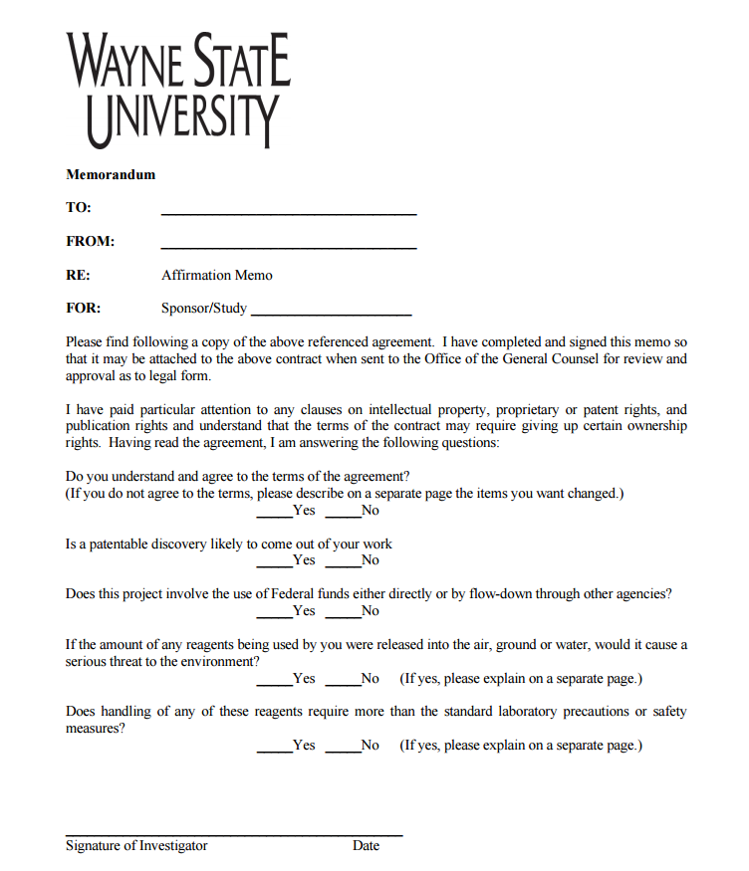
What Do I Need to Process a Contract Through SPA?
An affirmation memo signed by the Principal Investigator

Slide 31
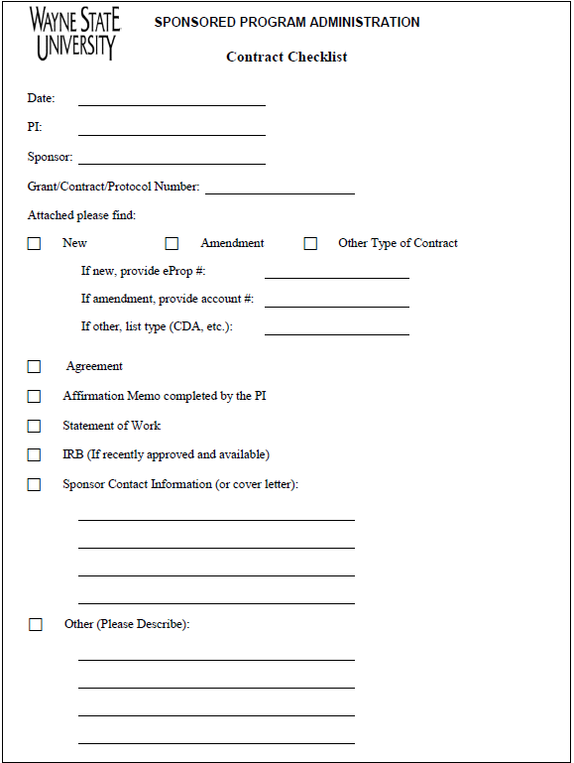
What Do I Need to Process a Contract Through SPA?
A completed checklist

Slide 32
Changes to the Scope of Work and/or Budget
Any time a sponsor requests or requires a change in the originally proposed budget or scope of work, the Principal Investigator should always notify and coordinate a response through SPA before submitting a revised budget or scope of work to the sponsor

Slide 33
Questions/Open Forum
Sponsored Program Administration: 577-3726
SPA.WAYNE.EDU

