Slide 1
SPA Training & Development
cost-sharing Basics

Slide 2
cost-sharing Basics
What is cost-sharing?
Impact
cost-sharing Procedure
Responsibilities
Resources

Slide 3
What is cost-sharing?
As defined in the Code of Federal Regulations (CFR) §200.306:
All contributions, including cash and third party in-kind, shall be accepted as part of the recipient's cost-sharing or matching when such contributions meet all of the following criteria:
(1) Are verifiable from the recipient's records.
(2) Are not included as contributions for any other federally-assisted project or program.
(3) Are necessary and reasonable for proper and efficient accomplishment of project or program objectives.

Slide 4
What is cost-sharing? (Cont.)
(4) Are allowable under the applicable cost principles.
(5) Are not paid by the Federal Government under another award, except where authorized by Federal statute to be used for cost-sharing or matching.
(6) Are provided for in the approved budget when required by the Federal awarding agency.
(7) Conform to other provisions of this Circular, as applicable

Slide 5
What is cost-sharing? - Simplified
The portion of project costs not funded by the sponsor
Clearly defined and directly allocable to a specific sponsored project
Expenditures that are necessary and reasonable to accomplish program objectives

Slide 6
Mandatory cost-sharing
Identified in the Request for Proposal from the sponsor
Required by the sponsor
Will be identified in the award documents
Must be reported to the sponsor in financial reports
Must be accounted for in University’s financial system and Effort Certification as committed cost share

Slide 7
Voluntary Committed
cost-sharing
Not explicitly required by the sponsor but has been offered by the PI and WSU in the application, proposal budget or budget justification
Commitment becomes binding once it is offered and the grant or contract has been awarded
Must be accounted for in University’s financial system and Effort Certification
Should be minimized whenever possible as it can lower WSU’s F & A rate

Slide 8
Voluntary Uncommitted
cost-sharing
Not explicitly required on a program
Above and beyond that which is committed and budgeted for in a sponsored project
Does not become part of “research base” and has no impact on WSU’s F&A rate

Slide 9
Committed vs. Uncommitted
Committed cost-sharing
Whether mandatory or voluntary, becomes a true obligation to the University once committed
Proposal Commitments = Award requirements
Voluntary Uncommitted cost-sharing
Treated differently than committed cost-sharing
Not included in organized research base for F&A rate purposes
Excluded from effort reporting requirements of A-21, Section J-8
Does NOT need to be documented

Slide 10
Impact of cost-sharing
Mandatory and Voluntary Committed cost-sharing on sponsored research projects is included in the Organized Research direct cost base
Included in the calculation of the Facilities and Administration (F&A, also known as Indirect costs) rate.
Increase in the direct cost base results in a decrease in WSU’s F&A rate and, consequently, a reduction of indirect cost revenue from sponsored projects.

Slide 11
Impact of cost-sharing (Cont.)
The “not so obvious” negative impacts of voluntary committed cost-sharing:
Lowers F&A rate
Complicates effort reporting system
Increases administrative costs for tracking/reporting
Creates the need to document two programs – direct costs and cost share

Slide 12
Impact of cost-sharing (Cont.)
Cumulatively, cost-sharing commitments reduce the University’s F&A cost rate
cost-sharing of direct expenses is considered part of the research base when calculating the University’s F&A rate
Excluded from the University’s pool of expenses
Lowers the amount of indirect expenses that can be allocated to sponsored projects
Reduces the University’s recovery of F&A costs

Slide 13
Impact of cost-sharing (Cont.)
In other words, WSU is tapped three times:
First – institutional resources are redistributed to make cost share available to a project
Second – the sponsor does not pay F&A costs on the cost shared items
Third – the University’s F&A rate is lowered in the next negotiation of F&A rate

Slide 14
Impact of C/S on F&A: Simplified
Basics of the F&A rate:
Pooled expenditures – those that cannot be allocated to a particular project (i.e. indirect costs)
Base expenditures – those direct expenses that make up an institution’s MTDC base
Rate = Pool
Base
Goal is to keep the pool high and the base low
Where does cost-sharing fit in?

Slide 15
C/S on F&A: Simplified Example
Indirect Expenses (pooled costs) = 100,000
MTDC Base = 200,000
Rate = 100,000 = 50%
200,000
Add 20,000 of cost-sharing expenses to base.
Indirect Expenses (pooled costs) = 100,000
MTDC Base = 220,000
Rate = 100,000 = 45.45%
220,000

Slide 16
Common Cost Shared Expenses
Personnel – time/effort of PI or others
Equipment – sometimes a required match for new equipment to be provided by the University
Use of existing equipment is usually not allowable as cost-sharing
Operational costs – supplies, travel, etc.
“In Kind” cost-sharing – donations by a third party
Quantifiable
Certification/documentation of actual contribution
Reduced or waived F&A rates

Slide 17
Common Cost Shared Expenses
cost-sharing by Sub-Recipients
cost-sharing requirements may be passed along to sub-recipients
Prime awardee retains ultimate responsibility for the commitment
Therefore, if sub-recipient does not meet match requirement, the prime awardee may need to scramble at the end of the project
Important to monitor as part of invoicing approval process, etc.

Slide 18
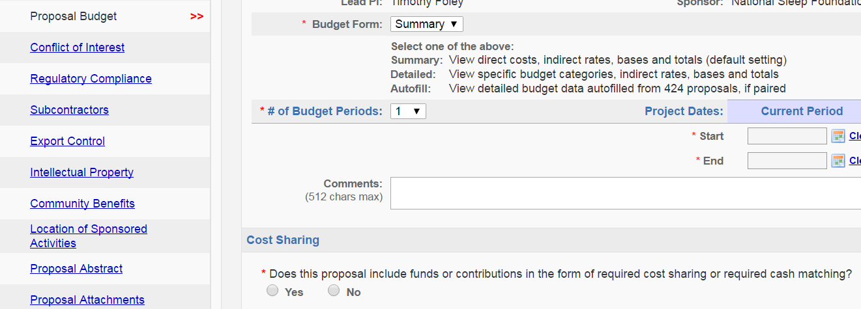
SPA Procedure
When cost-sharing on a project, ensure that pertinent information is listed in the Cayuse proposal record

Slide 19
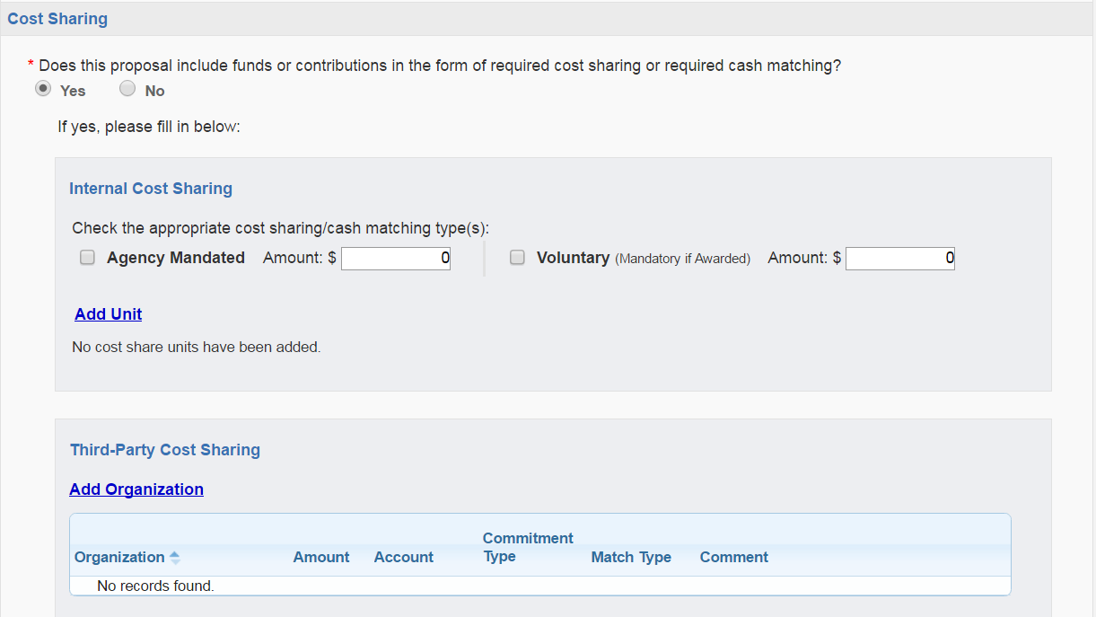
SPA Procedure (Cont.)
If there is cost-sharing on a proposal budget, Department must provide SPA pertinent information including, source account, type of cost-sharing, and funding unit or third-party organization

Slide 20
SPA Procedure (Cont.)
Once grant funds are awarded, SPA establishes a corresponding cost-sharing account that is “rolled-up” to the grant account

Slide 21
Responsibilities
Committed cost-sharing represents a binding commitment by the University to a sponsor and, as such, is subject to audit under federal and other sponsor regulations.
Any quantifiable cost offered in the proposal becomes a legally binding and accountable commitment of the University upon award.
cost-sharing must be documented in the same way as other charges.
Once a cost-sharing commitment is made, the principal investigator is required to measure, track, record, and be prepared to report the commitment.

Slide 22
Responsibilities (Cont.)
To avoid financial liability as a result of audit disallowance, it is the responsibility of the principal investigator to incur expenditures in accordance with applicable regulations and policies:
The cost principles and standards contained in OMB, 2 CFR 200, Uniform Guidance (Uniform Administrative Requirements, Cost Principles, and Audit Requirements for Federal Awards;

Slide 23
Responsibilities (Cont.)
Unfulfilled cost-sharing commitments or lack of documentation may result in a reduction of costs allowed against the sponsored project and a return of funds to the agency.
Also, the cost-sharing commitment is not automatically reduced when an award is reduced.
Should the awarded amount be reduced from the proposed amount, the committed cost-sharing may need to be adjusted accordingly, particularly if the awarded budget requires a change in the scope of work.

Slide 24
Responsibilities (Cont.)
When a Chair/Director or Dean approves a Cayuse proposal and cost-sharing is present, it indicates approval of the cost-sharing commitments being made by the campus unit.
This also indicates that the department is responsible for tracking and reporting cost share
Not just the PI’s responsibility
Imperative that Chairs, Directors, Deans, and SPA also review and approve cost-sharing commitments that are necessary, allowable and allocable
Failure to meet the pledged cost share can result in a reduction of agency funding, leading to an impact on unit resources

Slide 25
Resources
Checklist Summary:
Cost share only when absolutely necessary
Be prepared to track and report all cost share pledged or risk losing agency funding
Only cost share allowable direct costs that:
Qualify as allowable costs under provisions of 2 CFR 200
Will not duplicate the type of costs included in the University’s indirect cost rates
Have not been charged to any other federal contract or grant
Will occur within the project period

Slide 26
Resources (Cont.)
Cautionary Guidance:
cost-sharing commitments are normally stated in the budget but, can be stated in the budget justification or project narrative.
No matter where cost-sharing commitments are found within a proposal, statements of cost-sharing commitments are legally binding on WSU even when not mandated by the sponsor.
By using language in proposals that cites percentage of time, salaries or specific levels of effort, a commitment to cost-sharing is made – often unintentionally.
In instances where cost-sharing is specified and quantified, WSU is obligated to account for and track these commitments along with funds awarded by the sponsor.

Slide 27
Resources (Cont.)
Language Examples:
The following examples typify the indication of a cost-sharing commitment:
Wayne State University is fully supportive of this project and agrees to be responsible for the salary of the PI for its duration.
Dr. J is Principal Investigator of this project and will devote 40% effort (30% salary support requested) to the project.
The department of Chemistry will purchase a (equipment item) at ($xx,xxx) for exclusive use in support of Dr. J’s project.
The PI will contribute a week of field work and the time required for data analysis and report writing and will supply all equipment.
The PI will be contributing funds from other sources for use of (equipment) to ensure that the scope of work can be performed on the proposed.

Slide 28
Resources (Cont.)
Language Examples:
The following examples typify no indication of a cost-sharing commitment:
Dr. J will be providing expert advice and consultation to the project as needed.
Dr. J is Principal Investigator and requests 25% salary support for this project. He will provide additional support to the project as needed.
The PI will have access to additional resources, such as (equipment), to ensure the successful execution of the scope of work.
The university demonstrates support to the project through the availability and expertise of the Principal Investigator.
Dr. X will oversee all aspects of the project.

Slide 29
Resources (Cont.)
Language Examples:
The following is a list of terms that can indicate a commitment to cost-sharing:
cost-sharing
Sharing
Matching
In Kind
Donate
Commit % or $
Allocate % or $
Exclusive Use
Volunteer
Support at no cost
Contribute

Slide 30
Resources (Cont.)
Salary Cap:
A legislatively mandated provision limiting the direct salary an individual may receive under an NIH, SAMHSA or AHRQ grant or contract
An individual's base salary is NOT constrained, per se, by the legislative provision for a limitation of salary
The rate limitation simply limits the amount that may be awarded and charged to NIH grants and contracts
An institution may pay an individual's salary amount in excess of the salary cap with non-federal funds =
COST SHARE!!!

Slide 31
Resources (Cont.)
Salary Cap:
Salary limitation on NIH Grants to Executive Level II:
Please refer to the salary cap summary with times frames for existing salary caps, at
http://grants.nih.gov/grants/policy/salcap_summary.htm

Slide 32
Salary Cap:
The salary cap is based on an annualized rate for full time appointment - 2023
Annualized salary cap of $212,100 by FTE:
1.0 FTE = $212,100 ($212,100 X 1.0 FTE)
0.75 FTE = $159,075 ($212,100 X 0.75 FTE)
0.5 FTE = $106,050 ($212,100 X 0.5 FTE)
0.25 FTE = $53,025 ($212,100 X 0.25 FTE)
0.1 FTE = $21,210 ($212,100 X 0.1 FTE)

Slide 33
Salary Cap: % Labor Distribution (Dollar Method)
Divide the allowable salary support (percent effort commitment multiplied by NIH salary cap dollar amount) by the Base Salary amount
Calculating the salary cap (Dollar Method)
2023 Salary Cap |  | 212,100
Effort Commitment | X | 25%
Salary Support (Cap times Effort Commitment) |  | 53,025
Base Salary | ÷ | 250,000
% Labor Distribution (Salary Support divided by Base) |  | 21.21%
cost-sharing (Effort Commitment minus % Salary Distribution) |  | 3.79%

Slide 34
Salary Cap: % Labor Distribution (% Method)
Divide the allowable salary cap by the Base Salary amount and then multiply the result by the effort commitment
Calculating the salary cap (% Method)
2016 Salary Cap |  | 212,100
Base Salary | ÷ | 250,000
% of Base (Cap divided by Base Salary) |  | 84.84%
Effort Commitment | X | 25%
% Labor Distribution (% of Base times % Effort Commitment) |  | 21.21%
cost-sharing (Effort Commitment minus Salary Distribution) |  | 3.79%

Slide 35
Cost-Sharing on Sponsored Projects
QUESTIONS?
CONTACT YOUR GRANT/CONTRACT OFFICER
CONTACT SPA TRAINING:
Tim Foley 577-8357; tpfoley@wayne.edu

