Slide 1
Sponsored Projects:
Departmental Administration

Slide 2
Fundamentals
Wayne State University Research Environment
Roles & Responsibilities
Key Concepts
General Policies
Grant Life Cycle

Slide 3
What is Research Administration?
The management of the research and creative endeavor of the University
Enhance the success of faculty and staff in obtaining external funding for research and creative endeavors
Ensure compliance with sponsor and University requirements
Find Funding Source
Prepare Proposal
Accept/Setup Award
Manage Award
Closeout Award

Slide 4
What is a Research Administrator?
Administrative staff at all levels of the University that provide support for all research and sponsored programs

Slide 5
Payroll
College Administration
Human Resources
Department Administration
Service Centers
Research Administration
University Accounting
Compliance
University Administration
Purchasing
Post-Award Administration
Pre-Award Administration
Research Associates and Grad Students
Principal Investigators
Sponsors
Subrecipients/Contractors

Slide 7
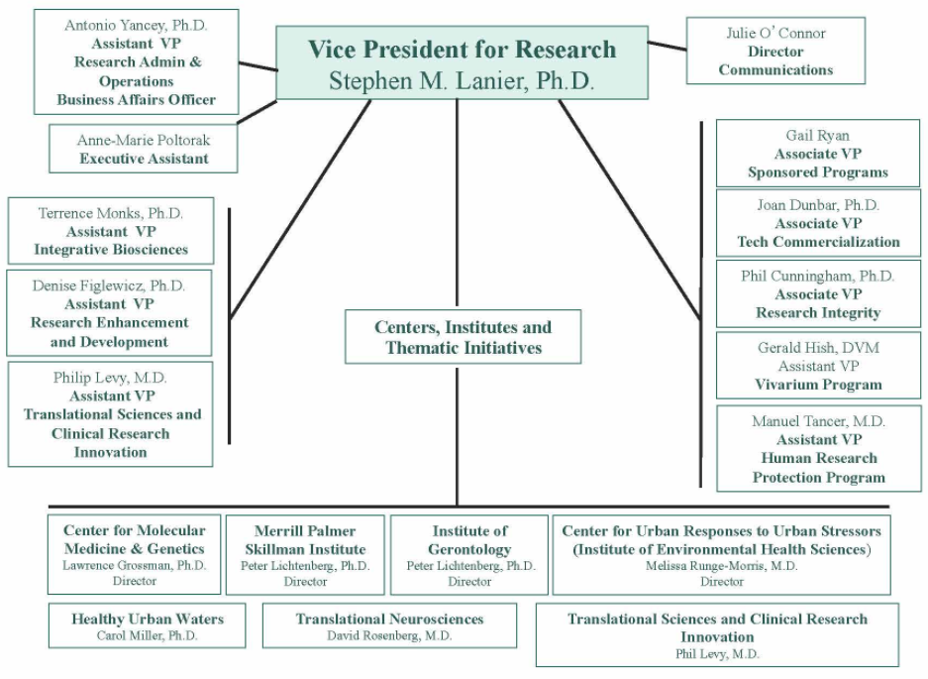

Slide 8
Office of the Vice President for Research
Sets research expectations and directions
Promotes integrity in the research enterprise
Advocates for research and graduate education
Assists in administering certain funds made available to provide:
Startup support for new faculty
Matching for external grants
Seed money for new projects that have the potential to attract funds from external sponsors

Slide 9
Sponsored Program Administration
Responsible for the institutional oversight for Wayne State University’s external sponsored programs. Provides services for three distinct groups:
1) faculty,
2) the University, and
3) the sponsors

Slide 10
Sponsored Program Administration
SPA plays a role throughout the lifecycle of the project that includes:
Proposal preparation and submission
Award acceptance
Successful completion of the project objectives
Closeout activities and final financial reporting

Slide 11
Research Compliance
IRB
Environmental Health and Safety
Research Misconduct
Stem Cell Research Oversight
Export Control
Conflict of Interest
IACUC
Notes:
Promotes responsible conduct of research at WSU, to assure compliance with federal, state and, university regulations and policies
Serve as a resource for research ethics education and training
Facilitates the research oversight process in accordance with federal regulations to protect the rights and welfare of research subjects, protect public and investigator health and safety
Ensure proper execution of research

Slide 12
Key Concepts
Sponsored Project – Any EXTERNALLY FUNDED research or scholarly activity
Notes:
Defined scope of work or set of objectives
Provides a basis for sponsor expectations
Activities involving funds, materials, compensation or exchange of in-kind efforts under awards or agreements

Slide 13
Sponsored Project – In Detail
“Exchange Transaction” between an external sponsor and recipient
Grant, contract, cooperative agreement, purchase order or any other mutually bonding agreement that restricts the use of funds or property and stipulates conditions with which the university must comply

Slide 14
Sponsored Project – In Detail
Includes provisions for audit by or on behalf of the sponsor
Involves the disposition of property, whether tangible or intangible, that may result from the project (e.g. equipment, records, inventions, copyrights, or rights in data)
Requires regulatory oversight in areas such as animal care, human subjects, biosafety, or financial conflict of interest

Slide 15
Activity Types
Research
Professional Development
Instruction
Training
Curriculum Development
Community and Public Service

Slide 16
Types of Awards
Grant
Assistance
Cooperative Agreement
Sponsored Projects
Procurement
Contract
Notes:
ASSISTANCE (click)
Grant: (click)
Awarded through a financial assistance mechanism, on behalf of an individual, in order to support the performance of research as denoted in the accepted application for funding.
Selected as the funding instrument when the sponsor does not expect significant programmatic involvement with the recipient during the performance of the scope of work.
Proposal responds to a formal RFA, RFP or other formal solicitation and the project is initiated by a notice of award
Statement of work specifies programmatic objectives that are to be accomplished within a delimited period of time and budget
Award requires deliverables or detailed technical reports
Award requires separate accounting procedures and detailed financial reports
A provision for audit by or on behalf of the sponsor
Involves the disposition of property, whether tangible or intangible, that may result from the project – equipment, records, inventions, copyrights, or rights in data
Award requires regulatory oversight in areas such as animal care, human subjects, biosafety, or financial conflict of interest
Cooperative agreement:
A funding mechanism which facilitates significantly more sponsor involvement and restrictions with the scope of work than a grant; however, sponsor has less oversight than with a contract
Primary objective of cooperative agreement is to transfer funds, services, personnel, equipment, or other resources to the University in order to achieve a public purpose aligned with the sponsor’s mission of support. EXAMPLE: NIH U01 awards provide support to recipients via a research project cooperative agreement
(CLICK) Procurement
Contract (Click) A legally binding agreement involving two or more parties that sets forth what the parties will or will not do
Majority of contracts must be in writing to be enforceable
Mutual agreement between parties to provide each other some benefit, such as a promise to pay money in exchange for a promise to deliver specified goods or services or the actual delivery of those goods and services
Normally requires one party to make a reasonably detailed offer to do something – including, typically, the price, time for performance and other essential terms and conditions – and the other to accept without significant change
Sponsor is procuring research from the institution and acts as the technical overseer
Principal purpose of the contract is for the sponsor to acquire property or services for direct benefit and use
Substantial involvement between sponsor and recipient during the performance of the activity
Research Agreement
Material Transfer Agreement
Non-Disclosure Agreement
License Agreement
Generally, a sponsor will request a specific research interest or service with the process provided of how the work will be conducted
Thorough description
Unsolicited announcement type
Deliverables outlined
Expectations, milestones, time-frame
Less flexibility
Cost reimbursement – provides for actual direct and indirect costs for the performance of outlined tasks
Costs that are not encumbered will be returned to the sponsor
Offers the least risk to the university – insinuates that a valiant effort will be made to complete the tasks but offers no guarantee of specific results
Fixed price – provides fixed allotment as a total-sum payment or aggregated payment schedule to complete outlined tasks
Need to be utilized only when costs for a delivery of product or allotment amount are effortlessly definable
More risk to university – defined task results are still required even if the total-sum payment is not enough to cover the costs of the project

Slide 17
Roles & Responsibilities
Principal Investigator
Responsible for the sponsored project's overall programmatic and financial direction
Decides how best to allocate the available financial resources to successfully carry out the project activities, and may require the department's assistance with the routine paperwork associated with the obligation and expenditure of funds and in the regular review of the project's fiscal status.
Notes:
The PI takes on the primary leadership role for a sponsored research project. During the application development, the PI is officially designated on the corresponding eProp which populates the PI designation. By completing the prop, the PI certifies that the information provided is true and correct and agrees to take responsibility for the proper conduct of the project as delineated in the application.
Administration of sponsored research projects is a joint effort between the PI and Wayne State University. A PI will be held accountable for the appropriate fiscal management and conduct of the research project. Sponsors hold Wayne State University legally and financially responsible for the performance of the scope of work funded and accountable for the proper use of funds.

Slide 18
Principal Investigator
Ultimately responsible to his or her departmental administrator for resolving in a timely manner any over-expenditures or unallowable costs that occur on a sponsored project
Assumes responsibility for project fiscal management; for adhering to all guidelines, policies and regulations; and for reporting requirements, including the reporting of inventions or financial conflicts of interest

Slide 19
Research Administrator
Helps facilitate research or other activity by assisting with management of sponsored projects, enabling faculty to focus on project work
Maintains current knowledge of sponsor regulations and WSU policies and procedures involving all phases of sponsored project management
Assists with routine paperwork associated with the obligation and expenditure of funds and in the regular review of the project's fiscal status

Slide 20
Typical Research Administrator Functions
Promote best practices in grant administration
Identify funding sources
Oversee compliance with funding agency regulations and standards
Ensure timely submission of progress reports and closeout reports

Slide 21
Typical Research Administrator Functions
Familiarize faculty with guidelines and requirements of grant applications
Familiarize investigators and staff with the scientific and financial responsibilities of the grant
Provide proposal and budget templates

Slide 22
Typical Research Administrator Functions
Helps PI apply for grants
Assistance with budget preparation
Completion of forms
Meeting deadlines
Seeking approvals
Obtaining signatures
Reviews applications, budgets and applicable paperwork prior to submission
Review awards and negotiation

Slide 23
College Dean’s Office
General oversight of the sponsored activities performed within the college, which may include:
Ensuring that departments have adequate facilities and other resources for achieving project aims
Ensure faculty time commitments on sponsored projects does not conflict with other departmental or University responsibilities
Monitor departmental financial resources
Ensure departmental compliance with the various regulatory requirements of the sponsors and the University

Slide 24
Sponsored Programs Administration
Responsible for authorizing all projects to external sponsors and assisting the Principal Investigator, Department Administrator, and College Administrator throughout the grant life-cycle
Legally authorized to submit proposals to external sponsors,
Accept and establish awards
Negotiate/sign contracts on behalf of the University

Slide 25
Responsibility Matrix
Function | DA Responsibilities | DA Facilitation Role | Leadership or Support provided by
General Management | Understand general management principles and apply them to departmental management | Acts as a role model for good management principles and participates in integration of management training throughout the organization | Departmental Administrator’s supervisor encourages and supports a quality management program
Preparing Grant applications | Ensure completion, accuracy and submit on time for institutional review; ensure policies are followed; identify cost-share; be aware of corresponding IRB and IACUC submissions | Provide attention to detail. Ensures proposal is compliant with all requirements (page numbers, font type, organizational structure) | Principal Investigator: provides science, participates in budget preparation and completion of IRB/IACUC/COI, etc., when applicable SPA: review/approve/submit on behalf of university
Expenditure Control | Ensure funds are sufficient for financial commitment; follow cost principles and expend funds within budget period; ensure WSU expenditure policies are adhered to | Prepare and process requests with clear and sufficient explanation and documentation to ensure completeness and expediency; discuss any exceptions with SPA | PI: direct expenditure of funds for project benefit SPA Accounting: Ensure direct expenses are coded correctly and that correct F&A rate is applied for life of the award
Notes:
Basic list of responsibilities, specific or shared

Slide 26
Responsibility Matrix
Function | DA Responsibilities | DA Facilitation Role | Leadership or Support provided by
Cost Transfers | Justification for cost transfer is clear and concise | Track cost where the work/use occurred, not just where it is charged; reconcile and document changes; review regulations to identify allowable exceptions | SPA Accounting: review and record justification for cost transfer; ensure F&A adjustments are made, if necessary
Purchasing of goods and services | Ensure that PI has specified requirements in a manner that promotes competitive bidding and impartial buying; compliance with University policies | Aware of process timing, sole source documentation and institutional dollar values assigned to items, e.g. equipment | Purchasing: ensures vendor is not debarred, secures competitive quotes, determines best value; ensures institutional policies are followed
Labor Certification | Ensure that labor distribution information is verified and filed for audit | Aware of interpretation of distribution and process for communicating variances | PI or DA: review labor distributions and certify that cost is a reasonable approximation of effort/cost expended
Compliance | Awareness of compliance program and process; actively participate in process and programs | Inform departmental faculty and staff of proper compliance practices; ensures implementation of compliance programs | Works closely with institutional compliance to ensure that department is operated in conformity with institution’s compliance program

Slide 27
Responsibility Matrix
Function | DA Responsibilities | DA Facilitation Role | Leadership or Support provided by
Reporting Requirements | Track reporting requirements and submit reports as necessary | Provide shadow bookkeeping, particularly for unprocessed and informally committed items | PI: provides programmatic reporting (ensures that all reporting requirements are met, with assistance from SPA)
Close-out | Close purchase orders, transfer labor allocations to new accounts at conclusion of award, files required reports, work with SPA to close award | Review prior to end date to ensure all processing is in order; check on outstanding issues: POs, salary charges, invoices, etc. | PI: prepares final technical report, invention/patent report, disclosure statements, reviews and monitors final financial reports SPA: oversees and assists process
Technology and Commercialization | Ensure PI is aware of requirement to report potential patent/copyright material to institutional officer | Communicate with PI and coordinate timing of reports with Technology Commercialization | PI: prepare necessary report SPA: oversee and assist process Technology Commercialization: files patent/copyright, licenses technology

Slide 28
SPA Roles & Responsibility Matrix
The Sponsored Program Roles and Responsibilities Matrix
identifies the major steps in the life cycle of an award - from proposal to closeout
assigns primary responsibility for each step to the principal investigator, the department, school or college, or to SPA
provides descriptions of the various activities within the life cycle of an award and clearly defines allocation of responsibilities in the process.
If you have questions regarding this matrix, please contact Sponsored Program Administration at 577-3726

Slide 29
Basic Responsibilities
Fund identification
Department Administrator
Find out which fund you are responsible for (including funds that may have been terminated with balances or funds forgotten by predecessors)
Find out which active and inactive accounts you are responsible for
Notes:
Breaking the matrix down

Slide 30
Basic Responsibilities
Guidelines and Policies
SPA
Provides guidance in interpretation of University and agency guidelines and polices
Maintains the University’s official award record for Sponsored Projects
Department Administrator:
Understand and keep informed of requirements stated in award document, university and agency guidelines
Follow record retention policies of the University
Notes:
Breaking the matrix down

Slide 31
Basic Responsibilities
Fund Setup
SPA
Set up index, fund and other accounting attributes that drive WSU’s reporting and ledger processes
Department Administrator:
Review FOAPAL and fund setup for accuracy; notify SPA of needed changes
Initiate action to assign appropriate personnel to project
Notes:
Breaking the matrix down

Slide 32
Basic Responsibilities
Financial Transactions
SPA
Certify to funders that award expenditures comply with award financial terms and conditions, as well as WSU and agency policies
Audit expense transfers for compliance
Department Administrator:
Approve financial transactions to be charged to project
Monitor expenses according to award budget
Ensure charges allocated to project are appropriate under terms and conditions
Monitor the operating ledger and resolve incorrect charges
Notes:
Breaking the matrix down

Slide 33
Basic Responsibilities
Cost Sharing
SPA
Establish corresponding cost-share account
Monitor cost-share reporting to ensure formal cost-share commitments are met
Department Administrator:
Ensure cost-sharing account is established
Track expenses
Initiate action to assign appropriate personnel to project
Notes:
Breaking the matrix down

Slide 34
Basic Responsibilities
Effort Reporting
SPA
Notify faculty and staff to review Effort Reports
Review reporting to make sure compliance guidelines are followed and effort is certified
Department Administrator:
Review effort percentages reported
Check payroll expenses
Confirm 100% certification prior to deadline
Notes:
Breaking the matrix down

Slide 35
Basic Responsibilities
Award Management
SPA
Provide expertise and training on post award administration to departments and PIs
Monitor and assist with award management
Department Administrator:
Assist PIs with award management
Monitor budget vs. expense and keep PI apprised of fiscal status on monthly or quarterly basis
Help maximize use of funds
Assist with deliverables and deadlines
Help prepare No-cost extensions, budget revisions
Resolve overdrafts
Maintain department award records
Notes:
Breaking the matrix down

Slide 36
Basic Responsibilities
Reporting and Billing
SPA
Submit financial reports to sponsor
Bill agencies for payment
Manage reconciliation and collection of payment
Department Administrator:
Monitor outstanding receivables to assist with identifying any payment issues which may be related to performance issues
Provide information for financial reports to PIs and business officers as required
Help SPA submit financial reports on time
Notes:
Breaking the matrix down

Slide 37
Basic Responsibilities
Fund closeout
SPA
Zero fund balances; close and inactivate funds
Department Administrator:
Make sure that subsequent adjustments reported to SPA corresponds with the final ledger
Cooperate with SPA to zero balances: transfer phone lines, liquidate open encumbrances, move personnel, etc.
Prepare indices and funds for termination
Notes:
Breaking the matrix down

Slide 38
Life-Cycle
Find Funding Source
Prepare Proposal
Accept/Setup Award
Manage Award
Closeout Award

Slide 39
Proposal Preparation
Proposal Application Types
Interpreting Guidelines
Completing Sponsor Forms
Cayuse – SP and S2S

Slide 40
Types of Applications
New Submissions: | Submitted to a sponsor for the first time
Simultaneous submissions of a new application | Some federal sponsors will not review an application submitted simultaneously to another federal sponsor. Others will allow simultaneous submission but each sponsor must be informed of the other sponsor or sponsors reviewing the application Each submission to a different sponsor must be submitted to SPA via Cayuse and must undergo the same reviews as the original application

Slide 41
Types of Applications
Award transfer for a new faculty member | There are two basic mechanisms for transferring a new faculty member’s funded project to WSU: Entire award may be reissued to WSU Portions of the award may be transferred to WSU via sub award/subcontract
Resubmissions | If a sponsor rejects an application, the PI may use the feedback received from the reviewers to revise and resubmit the application (sponsor policies can differ on allowance) Resubmissions are processed as new applications in eProp (copy of original proposal can be made)

Slide 42
Types of Applications
Continuations – Non-competing Renewals/Progress Reports | Funds typically awarded one year at a time, based on availability, with the expectation that the entire project will be supported Some sponsors require the submission of a new application for each year of the project. These continuation applications are not subject to competitive review as was the initial application Progress Reports (NIH): a streamlined process for submitting most non-competitive renewals
Competing Continuations – Renewals | Request for additional funds for a current award to expand the scope of work Applications for renewal must be approved by SPA and submitted via Cayuse
Competing supplements – Revisions | Some federal programs provide supplements to successful research projects in order to fund auxiliary programs, such as research experiences for undergraduates Applications for supplements must be approved by SPA and submitted via Cayuse

Slide 43
Types of Applications
Collaborative applications | Used when investigators at two or more Universities wish to work together on a project, but wish to receive separate funding directly from the sponsor Each collaborator must submit a separate application. The applications, which must have the same title, are linked by a cover letter which accompanies each proposal and asks that they be reviewed as a unit Federal sponsors that allow the submission of collaborative proposals will provide guidelines
Subaward applications | If another university is preparing an application which includes WSU as a subrecipient, it will need a subaward application to incorporate in its submission to the prime sponsor Subaward applications undergo the same submission and review process as any other application

Slide 44
Types of Funding Opportunities
Announcement Type: | Announcement Name: | Applicable to:
Solicited | Request for Applications (RFA) | Grants, Cooperative Agreements
 | Funding Opportunity Announcement (FOA) | Grants, Cooperative Agreements
 | Request for Proposals (RFP) | Contracts
 | Request for Quotation (RFQ) | Contracts
 | Request for Bid (RFB) | Contracts
 | Broad Agency Announcement (BAA) | Grants, Cooperative Agreements, Contracts
Unsolicited | Program Announcement (PA) | Grants, Cooperative Agreements, Contracts

Slide 45
Completing Sponsor Requirements
Every sponsor has their own specific set of application requirements. Different sponsors often require some of the same information but, it is vital to know exactly what is required by the sponsor .
The following highlights SOME of the application requirements of the NIH and NSF, the two largest sponsors of WSU externally funded programs. Remember that some sponsors, primarily private organizations and foundations, may not provide specific application requirements
When preparing an application, it is the responsibility of the owning org department to ensure the guidelines for eligibility, format, content, and deadline date have been met

Slide 46
Sponsor Application Requirements
National Institutes of Health (NIH) |  | National Science Foundation (NSF)
Overall Format | Each section consecutively paginated | Each section individually paginated
 | Use 1 of 4 fonts (palatino linotype, Georgia, arial or Helvetica) @ size 11 or larger | Use arial, courier new, palatino linotype @ size 10 or larger; times new roman @ 11 or larger; computer modern family @ size 11 or larger
 | No more than 6 lines per inch | No more than 6 lines of text within a vertical space of 1 inch
 | At least ½ inch margins | At least 1 inch margins
 | No more than 15 characters per inch

Slide 47
Full Proposal
Submit to | Grants.gov via eProp to eRA Commons | Fastlane/Grants.gov via eProp
Contains | Face Page | Cover sheet
 | Project summary, relevance, project site(s), senior key personnel, other significant contributors, use of human stem cells | Project summary
 | Research grant table of contents | Table of contents
 | Detailed budget for initial budget period | budget
 | Budget for entire proposed budget period
 | Biographical sketch(es) format page | Biographical Sketch(es)
 | Resources Format Page | Facilities, Equipment, and Other Resources
 | Research Plan (in accordance with FOA/activity code) | Project Description (including results from prior NSF support)
 | Senior/Key Personnel Report Format Page | Current and Pending Support
 | Project Site format Page (needed for extra sites) | References cited
 | Personal Data form Page | Special Information & Supplementary Documentation
 | Appendices | Appendices

Slide 48
Sponsor Application Requirements
Project Summary/Abstract
Length | 30 line limit | 1 page limit
Contains | Part I – Abstract (30 line limit): | Summarize proposed activity suitable for publication
 | Succinctly and accurately describe proposed work | Use 3rd person
 | State long-term objectives and specific aims | State intellectual merit of proposed activity
 | Describe research design, rationale & techniques | State broader impacts resulting from proposed activity
 | Part II – Relevance Statement: | Write to be understood by a scientifically or technically literate reader
 | Show relevance to public health in 2 or 3 sentences
 | Use plain language

Slide 49
Sponsor Application Requirements
Project Summary/Abstract
Length | 30 line limit | 1 page limit
Contains | Part I – Abstract (30 line limit): | Summarize proposed activity suitable for publication
 | Succinctly and accurately describe proposed work | Use 3rd person
 | State long-term objectives and specific aims | State intellectual merit of proposed activity
 | Describe research design, rationale & techniques | State broader impacts resulting from proposed activity
 | Part II – Relevance Statement: | Write to be understood by a scientifically or technically literate reader
 | Show relevance to public health in 2 or 3 sentences
 | Use plain language

Slide 50
Sponsor Application Requirements
Project Description
Contains | Introduction (required for resubmissions) | Objectives
 | Specific Aims | Expected significance
 | Research Strategy | Relation to longer-term goals of the PI’s project & relation to present state of knowledge in the field
 |  | Prior NSF Funding
 | Part II – Relevance Statement: | Write to be understood by a scientifically or technically literate reader
 | Show relevance to public health in 2 or 3 sentences
Length | Table of page limits | 15 page limit

Slide 51
Biographical Sketch
Contains | Follow 398 Biographical Sketch Format Page | No specific form
 | Name | Professional preparation:
 | eRA Commons User Name (Account) | Undergraduate/Graduate/Postdoctoral
 | Position Title | Degree Yr/Degree Yr/Years
 | Education and Training: | Publications:
 | Institution/Degree/Year/Field | Up to 5 closely related
 | Personal Statement | Up to 5 other significant
 | Positions and honors | Synergistic activities (i.e. other contributions in field outside of professional responsibilities
 | Selected peer-reviewed publications | Collaborators and other affiliations (throughout entire career, not just on this project
 | Research support (note: different from other support as no dollars or effort included)
Length | Table of page limits | 2 page limit

Slide 52
Protocol Requirements
Institutional Review Board (IRB)
Institutional Animal Care and Use Committee (IACUC)
Notes:
Institutional Review Board (IRB) - Human Subjects
All research projects involving the use of human subjects will require review by the IRB. Project protocols may be subject to different types of review, including:
Full – Required if protocol involves significant deception, uses the researcher’s subjects or employees as research subjects, or has been reviewed by an expediting reviewer who wishes to refer the protocol to the full IRB. Process usually takes between 3-6 weeks
Exempt – Process usually takes between 5-7 business days. Ultimately, it is the responsibility of the IRB to declare exemption
Expedited – Can be used when research activities present no more than minimal risk to human subjects, and involve only procedures listed in the Federal Register. Process usually takes between 2-3 weeks
Once IRB review is complete, the protocol will either be approved or returned for changes.
When a PI wishes to utilize an existing protocol for a new application, the IRB will still need to be indicated as “pending” for the application submission. At time of award selection, the application protocol may be submitted to the IRB for review against the existing protocol to receive concordance approval. Once concordance approval is received from IRB, the application may indicate “approved” for the updated IRB protocol
Institutional Animal Care & Use Committee (IACUC) – Vertebrate Animals
The IACUC ensures that all animals in experimental research are used appropriately and are treated in accordance with the highest standards of humane care

Slide 53
Proposal Budget Development
Cost Components
Cost Principles
Budgeting Practice
Cost-Sharing
Indirect Costs

Slide 54
Budget Preparation:
The application budget is the second most important element of the application, following the project narrative.
Budget preparation requires attention to detail in regards to the budgeted amount, sponsor guidelines, Federal regulations and University policy.
Project budget is comprised of direct costs and F&A (indirect costs)
Project/application budget is a required element of all Federal grant submissions

Slide 55
Budget Preparation:
Read the program announcement
Read all pertinent agency instructions and documentation
Identify your contact person for information and translation

Slide 56
Budget Components: Direct Costs vs. Indirect Costs
Direct Costs – specific to a particular project
Salaries and fringe benefits
Travel
Supplies specific to project completion
Equipment
Consultants
Patient care/participant support costs
Subrecipients
Other direct costs

Slide 57
Indirect costs – incurred for common or joint objectives, not specific to a particular sponsored project
Operational maintenance
Depreciation
Departmental administration
Sponsored program administration
General administration
Utilities
Student services
Library

Slide 58
Allowable/Unallowable
The majority of external sponsored funding at Wayne State University is supplied by the Federal government
Higher education grantees receiving Federal support must abide by the cost accounting principles
Federal Office of Management and Budget (OMB)
2 CFR 200, Uniform Administrative Requirements, Cost Principles, and Audit Requirements for Federal Awards

Slide 59
An expense is allowable if it is:
REASONABLE – A prudent person would have purchased this item and paid this price
ALLOCABLE – It can reasonably be assigned to the activity/project
CONSISTENTLY TREATED – Like costs must be treated the same in like circumstances, as either direct or indirect costs
An unallowable cost is any expense or cost that is NOT eligible for reimbursement by the Federal government

Slide 60
Example
ALLOWABLE | UNALLOWABLE
Animal care costs | Office supplies
Patient travel, food, parking | Local phone service
Participant fees and incentives | Subscriptions
Publication/copying costs | Memberships
Rental or lease (off site space only) | Furniture
Shared facility charges | Postage
PI salary/fringe | Food for meetings, entertainment
Salary of research technician | Alcohol
 | Fees

Slide 61
Budget Types
Detailed Budget – the most common type of budget when submitting to Federal, state, or private/non-profit organizations. Line-by-line budget information for salary/fringe, supplies, travel, publication costs, subaward/consultant costs, etc.
Modular Budget – NIH specific budget required for new, renewal, resubmission, and revisions that request up to $250,000 in direct costs (less consortium F&A) and fall into one of the following funding supports mechanisms:
R01 – Research Project Grant Program
R03 – Small Grant Program
R15 – Academic Research Enhancement Award (AREA) Grant
R21 – Exploratory/Development Research Grant Award
R34 – Clinical Trial Planning Grant Program

Slide 62
Modular budgets should request funds in $25,000 increments for EACH year of the project
 | Year 1 | Year 2 | Year 3 | Year 4 | Year 5 | Total Project
DC less consortium F&A | 225,000 | 250,000 | 250,000 | 250,000 | 275,000 | 1,250,000
Consortium F&A | 25,000 | 25,000 | 25,000 | 25,000 | 25,000 | 125,000
Total Direct Costs | 250,000 | 275,000 | 275,000 | 275,000 | 300,000 | 1,375,000
NOTE: If the prime application utilizes a modular budget, the subaward site needs to prepare a modular budget for inclusion to the application

Slide 63
Direct Cost Line Items
Personnel – any WSU employee contributing to the completion of the project, including senior personnel, post docs, students, tech support, etc.
Institutional Base Salary – Base pay earned by WSU employee, excluding supplemental pay
Salary and Wages
Senior/Key Personnel must have measurable effort (1% or more)
Non-key personnel includes research assistants, technicians, post docs, analysts, etc.
TBAs are NOT key personnel
Faculty appointments may be either 12 months or 9 months and will affect effort calculation
NIH, AHRQ and SAMHSA follow the Federal Executive Level I Salary Cap

Slide 64
Effort Calculations –
Effort is a reflection of the time a person will spend working on a project
May be in person months
Personnel salary requested is based on estimated effort
EXAMPLE:
12 Month Appointment | 9 Month Appointment
Base Salary = $100,000 | Base Salary = $100,000
Effort = 3 months | Effort = 3 months
$100,000 / 12 months = $8,333 | $100,000 / 9 months = $11,111
$8,333 x 3 months = $24,999 | $11,111 x 3 months = $33,333
Notes:
12 Month Appointment 9 Month Appointment
Base Salary = $100,000 Base Salary = $100,000
Effort = 3 mos. Effort = 3 mos.
$100,000 / 12 mos. = $8,333 $100,000 / 9 mos. = $11,111
$8,333 x 3 mos. = $24,999 $11,111 x 3 mos. = $33,333

Slide 65
Fringe Benefits –
Negotiated and agreed upon by WSU’s cognizant agency – Department of Health and Human Services – and is used to calculate fringe benefits that are included in the application budget for each of the project personnel
Different rate applies to faculty and staff
Rate applied changes each fiscal year

Slide 66
Equipment – nonexpendable, tangible personal property having a useful life of more than one year and an acquisition cost of $5,000 or more
General purpose equipment (not limited to use for research, medical, scientific or other technical activities) is not usually allowable as a direct cost
Excluded from the F&A base when calculating F&A
Must have documentation that equipment is necessary for the completion of project and not readily available

Slide 67
Travel –
Must be directly related to the project
Only personnel on the project can have travel supported by project
Travel to meet with collaborators is allowable
Travel to present findings/outcomes is allowable
Must follow Wayne State University travel policies
Consultants –
Should be an expert in the field
If a commercial entity, it should be in the business of conducting this type of service
Apply IRS standard for independent contractor checklist (ICC) to determine if consultant or subrecipient

Slide 68
Supplies –
Must be necessary for completion of project and consistent with research plan
Start with most expensive
Group supplies into categories
General office supplies are not allowable
Other Direct Costs –
Non-supply costs
Subject costs
Payment
Meals
Parking
Service center fees
Vendor services
Animal care/per diems
Do not include unallowable or indirect costs
Check sponsor guidelines; sponsors may have different guidelines in FOA for other direct costs

Slide 69
Subrecipients –
Have same requirements as WSU has to the sponsor
WSU must incorporate subaward/subcontract into prime application
Each subrecipient must provide the following for an application
FCOI
Budget
Budget justification
Scope of work
Resources page
Sign-off by authorized institutional official

Slide 70
Indirect Cost Rate (F&A)
Wayne State University’s Indirect Cost Rate is calculated from a Modified Total Direct Cost base, which excludes the following specific budget items from the base:
Equipment
Capital expenditures
Rental costs of off-site facilities
Patient care costs
Tuition remission
Scholarships and fellowships
The portion of each subaward/subcontract in excess of $25,000 for the performance period of the project

Slide 71
Budget Example:
Personnel $ 50,000
Travel $ 1,500
Supplies $ 10,000
Other $ 2,500
Subaward $ 75,000
Total Direct Costs $139,000
MTDC Base $ 89,000
Indirect Costs (52.5%) $ 46,725
Total Project Cost $185,725
F&A calculated based on the Modified Total Direct Costs ($89,000)
Take $89,000 x .525 to calculate F&A
Calculate the direct costs and the F&A base separately, because they are two different calculations
Notes:
50k from the base 139k is excluded from the base --- or 50k from the subaward as the first 25k earns IDC

Slide 72
Budget Justification
A detailed explanation of the budget in narrative form. The justification needs to carefully justify all expenses that are included in the budget to show that each budget item is necessary for the successful completion of the project.
* Be sure that the budget justification matches what was put in the budget.

Slide 73
Helpful Tips -
Watch for budget limitations and restrictions
Some sponsors only allow a certain amount of F&A charged (capped rate)
Animals needed for completion of research DO cost money; do no forget to include coverage
Check, double check, and triple check the budget and budget justification
Do not over-budget personnel
Do not under-budget supplies
Check for typos
Make sure all dates are in sync
Be careful when classifying consultant vs. subrecipient vs. vendor

Slide 74
Cayuse –
All grant and contract proposals must be entered in Cayuse SP to be processed through Sponsored Program Administration
Cayuse is a tool used by departmental faculty and staff as well as Sponsored Program Administration Grant and Contract Officers in preparation, review and submittal of applications
Cayuse Research Suite Resources and Training

Slide 75
Cayuse -
Prepare administrative sections of an application such as the budget, budget justification. Abstract, and facilities and resources pages
Routes a completed application for departmental, college and central review and approval
Acts as a database for managing sponsored projects activity for the University

Slide 76
Award Management
Acceptance
Set-up
Project Changes
Sub-Award Monitoring
Cost-Share Obligations
Reporting Obligations

Slide 77
Award Acceptance
Depending on the type of award sponsors will indicate in the award notice if there are any additional acceptance requirements of Wayne State University
Notes:
Receives official award notice*; Please note: If the PI receives an award notice directly from a sponsor, contact the assigned SPA Grant and Contract Officer to verify that they have also received the award notice
Reviews the terms and conditions and any special terms;
Reviews the budget;
Signs on behalf of WSU and returns the fully executed documents to the sponsor (when applicable);
Distributes the sponsor's award notice, including any attachments to the PI, department, and college;
Establishes the corresponding award account in Banner;
Enters the award information and sets the status to funded within Coeus

Slide 78
Notice of Award (NOA)
Funding instrument sponsors utilize to award grants.
Standard components:
Grant Assignment Number;
Principal Investigator identified;
Budget Period and Performance Period identified;
Amount obligated in the current budget period
Summary table of projected (tentative) award totals by year

Slide 79
Indicates expanded authority to determine if carry over is allowable
Special terms
Additional Sponsor key personnel by name
Restrictions on the award
Additional reporting requirements
Provides the sponsor contact information

Slide 80
Grant/Fund Authorization Form (GFA)
Captures essential information related to actions against an award account throughout the lifecycle of the award:
Grant and fund numbers
Index number
Cost-share number
Awarded amount
Programmatic or administrative change that involves Sponsored Program Administration oversight or assistance

Slide 81
Award Management
Post Award Administration involves a broad set of activities regarding the management of sponsored funds, compliance with federal regulations and adherence to Wayne State University policies and procedures
Sound management of sponsored programs is critical in maintaining the public trust in research results and outcomes, research participants and how funds are spent

Slide 82
Award
Review award document
Award management and changes
Notes:
Review award document:
check for restrictions or special stipulations

Slide 83
Award – Review Document
Understand critical information in the award document, applicable agency guidelines, and federal guidelines
Review the documents attached to your award and make note of anything that will help you support the Principal Investigator (PI).
Notes:
Review award document:
check for restrictions or special stipulations

Slide 84
Award – Review Document
Use this list to help identify information in the award document:
Project Period: What is the earliest date and the last termination date for all periods of the project (which may include several budget periods)?
Award amount for the project period: What is the cumulative amount legally committed and encumbered by the agency for all budget periods? This may include obligated funding for a current period plus pending funding for future periods
Budget Period: Does the award specify annual periods for performance, spending, or payment for a project continuing more than one year? When do each of theses annual periods start and end? What are the terms for each budget period?
Notes:
Review award document:
check for restrictions or special stipulations

Slide 85
Award – Review Document
Award amount per budget period: Has the agency specified an amount obligated or restricted for the specific budget period? Has the agency committed only a portion of the total project funding at the time the award is executed?
If so, what are the conditions for future pending funding to be activated or become obligated? For example, when the future budget period is reached is funding automatically obligated or will the agency send formal notice?
If the award specifies a limit on what can be spent for each budget period, what are the terms regarding overspending or underspending?
Many agencies fund projects in increments. Look for terminology that requires an accounting for each budget period and a refund of the unexpended balance for each period. In these cases you might need approval to spend unexpended balance past the termination date or to spend more than the budgeted amount

Slide 86
Award – Review Document
Award budget: Determine the amount awarded for each budget period, if applicable, and for each expense category (salary, supplies, travel, equipment, IDC)
Unallowable expenses: Determine expenses the agency doesn’t allow as a direct cost (e.g., foreign travel is not allowed by many agencies)
After reviewing agency terms, check to see if any normally unallowable expenses are approved in the award budget. Generally, if an expense is approved in the budget, the agency has approved it as a direct cost.
For federal funds, Uniform Guidance cost principles may override approvals in the award budget. For guidance on expense allowability, contact Sponsored Programs Administration
Notes:
Review award document:
check for restrictions or special stipulations

Slide 87
Award – Review Document
Expense limitations: Are any expense categories limited to a specific amount within a budget or project period? For example, many agencies limit the amount that can be spent on travel for each budget year.
Rebudgeting requirements: If expenses exceed the budget for a particular category or the PI wants to spend in categories not previously budgeted, what are the terms for changing the approved budget? Some agencies allow a deviation within approved categories and some require approval for any change.
Billing and payment terms: Are there specific billing and payment terms and instructions?
Notes:
Review award document:
check for restrictions or special stipulations

Slide 88
Award – Review Document
Billing and payment terms: Are there specific billing and payment terms and instructions?
In general, conracts and grants are billed in some matter – grants from private sponsors are usually not billed; federal funds are drawn down via letter of credit
If billing is required, look for the billing schedule and additional requirements such as detail to be included on the invoice itself or reports to be submitted with the bill (e.g. cost-share report, equipment report)
If billed, SPA submits invoices to the agency and records them in Banner. The department is responsible for providing SPA with other required reports or attachments
Notes:
Review award document:
check for restrictions or special stipulations

Slide 89
Award – Review Document
If the award does not require submission of an invoice, look for terms regarding the amount and frequency of payment. Look for the manner of payment (wire transfer, check, etc.)
If you receive checks for any sponsored projects, forward to SPA for deposit.
Notes:
Review award document:
check for restrictions or special stipulations

Slide 90
Award – Review Document
Cost sharing: Contributions to the project for personnel or other expenses to be paid from other fund sources are considered mandatory committed cost sharing, if included in the award documents
Check the approved budget for salary or other itemized expenses budgeted at zero cost to the project
Review the budget narrative for language committing personnel time or other expenses at no cost to the project
If cost-sharing commitments are included, WSU is required to track and report these, and the PI must certify this contribution to the project
Notes:
Review award document:
check for restrictions or special stipulations

Slide 91
Award – Review Document
Lay out vision of the award structure
Create spending plan and assign proper labor distribution
Communicate plan with PI and users of account prior to set up budget
Align budgets to match requirements of award
Make monitoring easier for everyone
If applicable, communicate changes to SPA Grant & Contract Officer for review, approval prior to account establishment
Notes:
Review award document:
check for restrictions or special stipulations

Slide 92
Project Changes
Re-budgeting of funds
End date extension
Effort change
PI change
Carry forward of funds
Notes:
Changes to the proposed plan, budget or scope sometimes occur over the course of an award
Budget changes
End date extensions
Effort change
PI change
Carry forward requests

Slide 93
“Expanded Authority”
Grant certain allowances to some research grants (e.g. FDP awards)
Provides latitude to grantee to rebudget within and between budget categories
Degree of discretion varies by the type of grant and sponsor
Some agencies may require approval of budget and project changes
Approval must be granted before any changes can occur

Slide 94
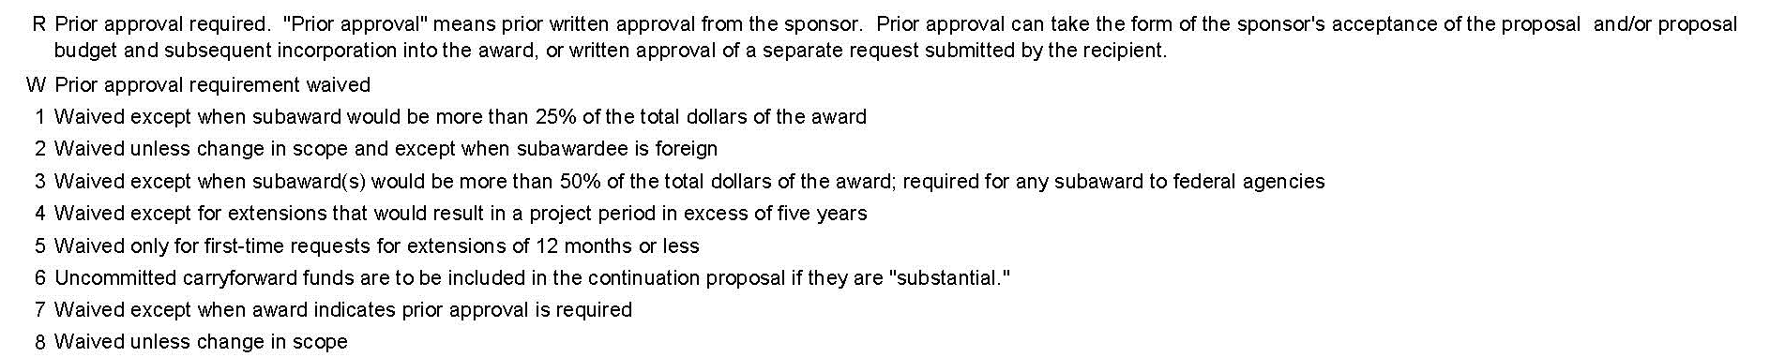
Complete FDP Prior Approval Matrix

Slide 95
Sponsor Approval
Rebudgeting requests that require the sponsor’s prior approval are made in writing
Should provide such information as reason why the funds are needed, reason why the funds are available, and the anticipated dollar amounts
Various sponsors require that the request be cosigned by the Principal Investigator and a University Official (SPA)
SPA will submit request on behalf of the University

Slide 96
Rebudgeting Requests – Keep In Mind
Most agencies require a rebudgeting request if you exceed certain expense threshold in your fund. A rebudgeting request is an amendment to the award agreement and must be formally submitted to the agency for official approval
In General
Review expenditure balances per the budget
Review your expense projections
Plan your rebudgeting needs, making sure the request will cover expenses for the entire budget or project period
Determine which categories need to be increased and decreased
Determine if IDC is affected and increase/decrease accordingly
If applicable, prepare letter of request incuding: amounts increased, amounts decreased and justification for change
Notes:
25% variance

Slide 97
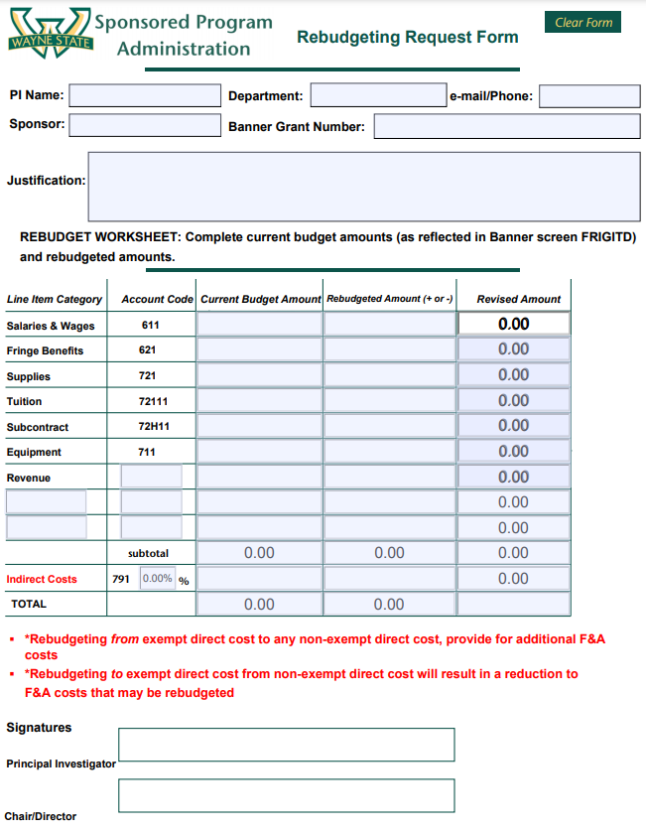
SPA Rebudgeting Request Form

Slide 98
Calculations for Re-budgeting of Funds
Most Sponsors do not restrict the re-budgeting of funds to and from indirect costs, therefore care should be taken to consider the impact on F&A Costs when re-budgeting funds
EXAMPLE 1: Equipment Funds needed: $5,000
Need $5,000 for equipment; funds are available in Supplies
F&A Costs are not computed on Equipment but are computed on Supplies, the calculation is as follows:
(Amt. needed) / (1 + I/C rate)
$5,000/1.525 = $3,279.00 Amount from Supplies
(Amt. from Supplies) x (I/C rate)
$3,279.00 x .525 = 1,722.00 Amount from F&A Cost
Amt. from Supplies + Amt. from Indirect Cost = $5,000.00 Amount to Equipment

Slide 99
EXAMPLE 2: Supplies Funds needed: $1,000
Need $1,000 for Supplies; funds are available in Equipment. F&A Costs are computed on Supplies but not on Equipment, the computation is as follows:
(Amount of Supplies needed) x (I/C rate)
$1,000 x .525 = $525.00 I/C needed
Amount of Supplies + Associated I/C
$1,000 + $525 = $1,525 Amount Re-budgeted from Equipment

Slide 100
No-Cost Extensions
Due to unanticipated circumstances, a project might need additional time to complete
A no-cost extension is a request for additional time with no-cost, or additional funding, from the sponsor
Requests must be submitted to SPA
cause of delay
objectives to be accomplished
period of extension
Requesting an extension simply to allow sufficient time to spend the available balance is not acceptable

Slide 101
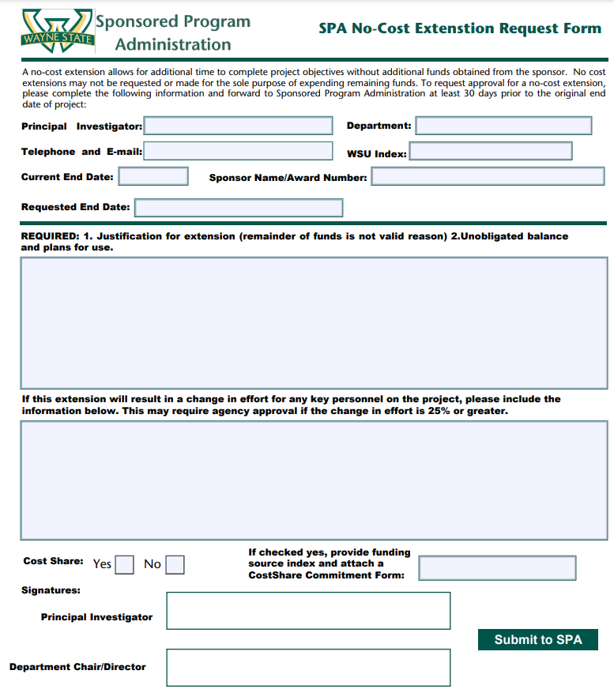
SPA No-Cost Extension Request Form

Slide 102
No-Cost Extensions - Keep In Mind
Extension may be issued unless one or more of the following conditions/restrictions apply:
Terms and conditions of the award prohibit the extension
Extension requires additional federal funds
Extension involves any change in the approved objectives or scope of the project
Extensions longer than twelve months must be requested. If the University approves a request for an extension of less than twelve months and the principal investigator subsequently wishes to lengthen that time period to a total of twelve months or longer, agency approval must be obtained

Slide 103
No-Cost Extensions - Keep In Mind
Unless otherwise specified, requests to extend a project period must be received by the agency at least 10 days before the expiration date of the grant
Written requests must be reviewed, authorized, and submitted to the sponsor by SPA

Slide 104
Carry Forward Requests- Keep In Mind
Occurs when unspent funds are transferred from one budget period to a separately funded budget period
Could refer to a transfer between periods in the same fund or between funds if the project continues with a new number
Review agency polices to determine requirements
Prepare letter to sponsor
Revised budget
Justification
All requests funnel through SPA

Slide 105
Sub-Award Monitoring
WSU is responsible for ensuring that sponsor funds, including those provided by WSU to other entities, are spent in accordance with all applicable laws and regulations
The University is required to monitor its subrecipients in its role as prime awardee

Slide 106
Sub-Award - PI & Department Responsibilities
PI and Administrator responsibility
to monitor subrecipients for reasonable assurance that the award is used for authorized purposes,
To ensure compliance with laws, regulation, and the provisions of the agreement,
invoices are for allowable expenses in accordance with the agreement, and that subrecipient achieves its performance goals

Slide 107
Sub-Award - PI & Department Responsibilities
PI and department administrator must review the subrecipient’s invoices and indicate approval by signing each invoice for payment
Verify that the invoice was prepared in accordance with the subaward requirements and that invoiced costs are:
In accordance with the approved budget or permissible rebudgeting
Incurred within the approved period of performance and overall cost limitations
Aligned in terms of cost and type of expense with the scientific progress reported to date
Allowable, allocable, and reasonable

Slide 108
Sub-Award – Keep In Mind
The sub-recipient’s invoices should reflect both current period and cumulative expenses to date.
The PI and departmental administrators should also verify that the sub-recipient is adequately meeting any cost-sharing commitments made for the sub-award.
Require justification of costs from sub-recipient if level of detail is not sufficient
Notes:
In the event the level of detail included on an invoice is not sufficient to fully understand the costs, or if it appears that some costs may be excessive or understated, the PI or departmental administrator should question the subrecipient's expenditures by requesting further documentation or explanation prior to approving an invoice.
If the explanations are not sufficient to render a prudent judgment on the allowability of the cost, and the terms of the subaward permit, department grant administrators may request detailed justifications from subrecipient.
Department administrators may also periodically request, if the terms of the subcontract permit, particularly from high-risk subrecipients, detailed support for selected invoiced charges to verify their appropriateness and reasonableness. Such inquiries must be done in a timely manner (e.g., within thirty days after receipt of an invoice) so that the subrecipient can be promptly paid for approved costs.

Slide 109
Close-Out – Final Reports
Closeout
Financial
Technical
Property
Inventions
Notes:
These reports are generally viewed as the University’s fundamental obligation to the sponsor
Due at completion of project work --- typically 90 days from project end
Private sponsor guidelines may have different stipulations and timeframes and award documents or contract should reference this information
Requirements are typically outlined in award documents or within contract language

Slide 110
Final Reports - Financial
Financial Status Report is prepared by the SPA Finance and Reporting team
Reporting Accountant consults with the appropriate administrator regarding any outstanding charges, unliquidated obligations, etc.
The report is sent to the PI for review prior to submission to the sponsor
Notes:
Contracts are typically invoiced on a monthly basis
Other payment schedule could be outlined in contract (quarterly, milestone)
Performance based
Fixed Price

Slide 111
Final Reports - Technical
Unless otherwise indicated, “final performance reports are due 90 calendar days after the expiration or termination of the award."
Outlines project activities in sufficient detail
Detailed description of data collection and analysis procedures, modifications to or problems with the original research design, findings, and conclusions
Notes:
*as stated in NIH guidelines

Slide 112
Final Reports - Invention
The University submits a Final Invention Report or Statement and Certification, whether or not invention(s) resulted from work under the grant, when required by sponsor
Must be signed by the PI and an authorized institutional official
Report must list all inventions that were conceived or first actually reduced to practice during the course of work under the project, whether or not previously reported
If there were no inventions, the statement should indicate "None.“
The PI is responsible for generating this report and it should be processed through SPA who will work with the Technology Commercialization office to obtain the appropriate signature
Notes:
*May or may not be required, depending on sponsor guidelines

Slide 113
Final Reports - Property
WSU must account for any real or personal property acquired with the use of federal funds
A report is prepared by SPA and Fiscal Operations using agency forms identifying the equipment purchased, acquisition cost, make, model number, serial number, WSU inventory number, and condition
If the terms of the award do not automatically give title to the University, a letter is sent to the agency requesting transfer of title to the University
WSU Policy regarding Equipment
Notes:
For purposes of this policy, capitalized equipment is defined as and encompasses all tangible, nonexpendable personal property such as fixtures, furniture, and movable equipment that meets the University capitalization threshold of an initial cost of $5,000 or greater and a useful life of two or more years. As applicable, certain provisions of this policy (i.e. safeguarding assets, proper disposal, etc.) also apply to non-capitalized equipment.

Slide 114
Questions
&
Discussion

Slide 115
Sponsored Projects:
Departmental Administration

